Slide 1

Messaging With Limits
Concurrent, Multi-Stage Data Processing in the Real World
Notes:
Good morning, everybody and welcome to StirTrek! I hope everybody enjoyed their first session of the day. Over the next hour we're going to talk about sending messages to send messages.

Slide 2

Brian Meeker
Website
https://brianmeeker.me
GitHub
@CuriousCurmudgeon
Mastodon
@brianmeeker@hachyderm.io
Notes:
My name is Brian Meeker. I’ve spent most of my career in C#, but these days I'm an Elixir dev at GetThru. I've worked 100% remote since 2012 from Indiana, so it's always nice to get out and see people in person
You can mostly find me these days on Mastodon. These slides will be available on GitHub. I'll have a QR code link at the end to the repo and it will be shared to the Stir Trek 2024 repo as well.

Slide 3

Notes:
This isn't a sales talk, but I work for GetThru and this talk is about a system we've built, so I need to tell you a bit about what we do.
GetThru provides texting and calling tools for progressive political campaigns, non-profits, and universities. As you might have noticed, it's a presidential election year in the US, which means a lot more usage of our system. That led us to reevaluate our infrastructure to handle the load.

Slide 4


Notes:
We have two main products. ThruTalk is for phone banking. An education customer might use it to ask for donations during their university’s giving day. A political campaign might use it as part of a Get Out the Vote program.
For today though, we’re only going to be looking at ThruText. This is our main product. Those same kinds of use cases are possible with texting and you’re much more likely to “get thru” to somebody (pun intended). People don’t want to answer phone calls from an unrecognized number, but they will glance at a text message.

Slide 5
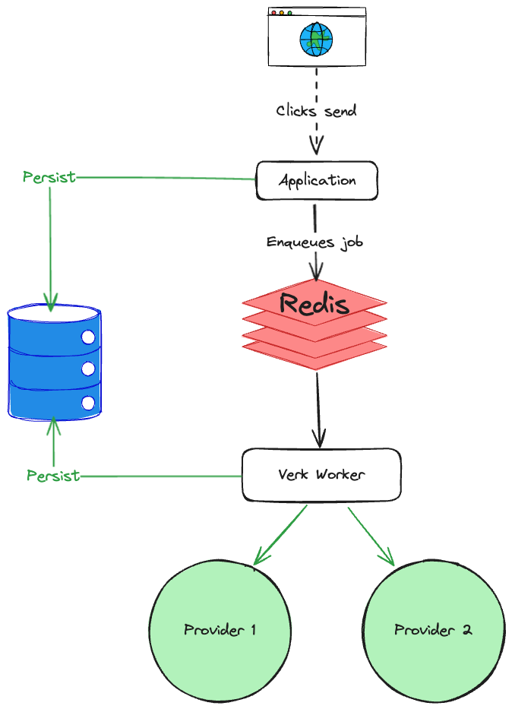
The Old System
Notes:
Let’s look at the old system to understand why we needed to build something new.
GetThru's codebase dates back to 2016. The backend has been Elixir from the start. Elixir started in 2012, but didn't release 1.0 until 2014. This means we probably have one of the oldest continually worked on Elixir codebases in existence. And like any system under development for a long time, core parts of the infrastructure have become creakier. People come and go. Institutional knowledge is lost. The domain changes.
Our existing system for sending messages relies on a Redis backed job processing library in the Elixir ecosystem called Verk. Unfortunately, Verk is now unmaintained and lacks good observability. One option would be to fork Verk and maintain it ourselves. We talked about doing that. But Verk has other issues as well. The biggest one was that it has no built in way to rate limit messages the way we need.
Finally, our current system shoved all the logic to send a message into one Verk worker. We loaded all the data and checked all the rate limits in one job. If a message was rate limited, it was difficult to know which rate limit had been hit. When we attempted to send the message again, we did all the work over. We loaded all the data from the DB again and checked all the rate limits again.

Slide 6

Providers
Notes:
To better understand what finally pushed the old system to its breaking point, we first need to go over a little bit of domain terminology.
First, we send text messages and we do that through providers. We don’t talk directly to carriers. Instead, providers are the services we use to send text messages through. Everybody here has probably heard of Twilio, but there are many others out there and we rely on multiple of them.

Slide 7




Carriers (or Mobile Network Operators)
Notes:
Mobile Network Operators are carriers like AT&T, Verizon, T-Mobile, and US Cellular. In the US, those are basically it. There are many virtual network operators in the US, but they all operate on these networks. Most importantly for later, when we send somebody a text message, we need to know who the underlying mobile network operator is.

Slide 8
Application-to-Person (A2P)
Notes:
When you send text messages on your phone to somebody, that is Person-to-Person (P2P) texting. Strictly speaking, what we do at GetThru is called Application-to-Person (A2P) texting. Even though our customers may end up having a conversation with the contact the message was sent to, that is still considered A2P because it was sent through a provder by our service, not somebody's phone directly.

Slide 9
10 Digit Long Codes (10DLC)
(555) 209-8165
Notes:
When sending those A2P messages in the US, we are sending them through a 10DLC (10 Digit Long Code). Basically, the carrier says you can use this 10 digit phone number for A2P text messaging subject to some limits.
Also, if you’re generating test data for your app, use the 555 area code. It’s been set aside. It’s the phone number equivalent of sending test emails to example.com. You should never accidentally text or call a real number

Slide 10

Notes:
And those 10DLC rules are administered by something called The Campaign Registry (TCR). Our old system had issues, but this is what really broke it.
TCR is an attempt at industry self-regulation by carriers to prevent federal regulation on A2P texting. They verify brands and campaigns prior to them being allowed to send A2P messages. It requires brands to submit information about themselves and their campaigns up front to provide traceability about the who and what of a campaign.
For example, if somebody running in a local election wants to send a get out of the vote message to a list of voters in their area, they must have first registered their brand with TCR and a political use case. The quality of the information they submit and their use case will be part of determining if they are approved, and, if approved, what their rate limits are. More about that later.
TCR was announced in 2021 and went into effect in 2022. Our current system has been struggling with it ever since.

Slide 11
Requirements
Lessen load on DB
Separation of concerns (rate limiting and business logic)
Respect all provider rate limits
Respect all TCR rate limits
Intelligent retries
Observability
Batch sending
Scheduled sending
Notes:
In 2023 we decided that continuing to build on the old system was not sustainable. We needed to start fresh.
One of the first things we did was to write an ADR (Architectural Decision Record). That document outlined the issues with the existing system, requirements for the new system, and a proposal for the architecture of the new system.
First, we needed to lessen the load on the DB. The existing system was putting a very heavy load on it. The way that everything had to be checked again on retry, no matter what caused the retry, was really hammering it. Plus, every message was inserted independently. That was a lot of independent writes. We like our monolith and if we want to keep it, we needed to lower the load on the DB.
We wanted a separation of concerns between rate limiting and business logic. The way we had bolted TCR rate limits onto the legacy system interleaved the two. This made it really hard to reason about.
We needed to respect all the TCR and provider rate limits. TCR rate limits had been bolted onto the legacy system and did not work well.
And related to that was intelligent retries. The legacy system made it hard to know why a message was being rate limited. Since everything was checked in just one job, it was not possible to gate how far a message got in the system by the type of rate limit that was being exceeded.
Observability was a must. This is pretty squishy as far as requirements go, but just about anything was going to be an improvement over our current situation. We needed to be able to answer detailed questions about the systems behavior and also be able to change certain aspects of that behavior at run time. We're big fans of OpenTelemetry, but we would have needed to fork Verk to hook in the telemetry we wanted.
One of the driving business use cases was batch sending. Being able to send out a batch of messages without user intervention for each message. For example, a university wants to send out a fundraising message when their campaign opens at 09:00 in the morning. The initial message is the same for everybody in that campaign. There is no need to for somebody to sit there and click a button over and over to send the message.
Related to that is scheduled send. The ability to schedule the messages to go out automatically at a certain time.
And beyond all of that was the opportunity to rebuild a core part of our system from scratch. We had lost institutional knowledge about the old system. There were legitimate business and technical reasons to build a new system, but regaining that institutional knowledge with the current team was appealing as well.

Slide 12





Tech Stack
Notes:
Our tech stack is very… different than most.
As I mentioned earlier, GetThru is a 100% Elixir shop. So, obviously we're going to continue using Elixir here. It's emphasis on concurrency also happens to be really well suited to this problem space. Does anybody else in this room work on an Elixir code base? If you don’t, don’t worry. I am not going to be throwing a bunch of Elixir code at you today.
We had a couple of existing options in our infrastructure for enqueuing jobs. First, we have Oban. Oban is the go-to job processing library in the Elixir ecosystem, having won out over Verk. The problem for us is that it's tied to Postgres. We love Postgres and we're already using Oban. We’re trying to move all of our old jobs from Verk to Oban. But we're also trying to reduce load on our DB. We could have stood up a second DB just for Oban, but that introduces its own complexities. We really like our monolith and limiting the amount of infrastructure we have to maintain.
That led us to Broadway. Broadway is designed for building concurrent and multi-stage data ingestion and data processing pipelines with Elixir. Importantly for us, it has fantastic support for rate limiting.
Broadway supports many different producers, which is what it calls adapters to consume data from a source such as RabbitMQ, Kafka, Amazon SQS and a few others out of the box. We already had RabbitMQ in our existing infrastructure, so that made it an easy choice. For us, it also has the niche advantage of being written in Erlang. Erlang and Elixir run on the same VM, so this helped us feel more comfortable in our ability to debug any issues.
Because we already had Rabbit in our system, we did not seriously evaluate alternatives like Kafka. They're very similar tools. We weren't interested in adding more services to our infrastructure or moving our current Rabbit systems over to anything else.
We also already had Redis in our infrastructure. Redis is a bit controversial in the Elixir ecosystem because the VM gives you so many of the same tools without needing to bring in another dependency. We like it though for our use cases.
Finally, our backend is Elixir and, through the power of Phoenix LiveView, our front end is too. If you’re familiar with Hotwire in the Rails world or Blazor in the C# world, LiveView is the OG version of that architecture style. We write almost no Javascript in our single page application.

Slide 13

Super Collider
Notes:
And all of that comes together into a project we code named Super Collider. And I will say, as someone who has historically rolled his eyes at cute project code names, AI image generation has made them a lot more fun than they used to be.

Slide 14
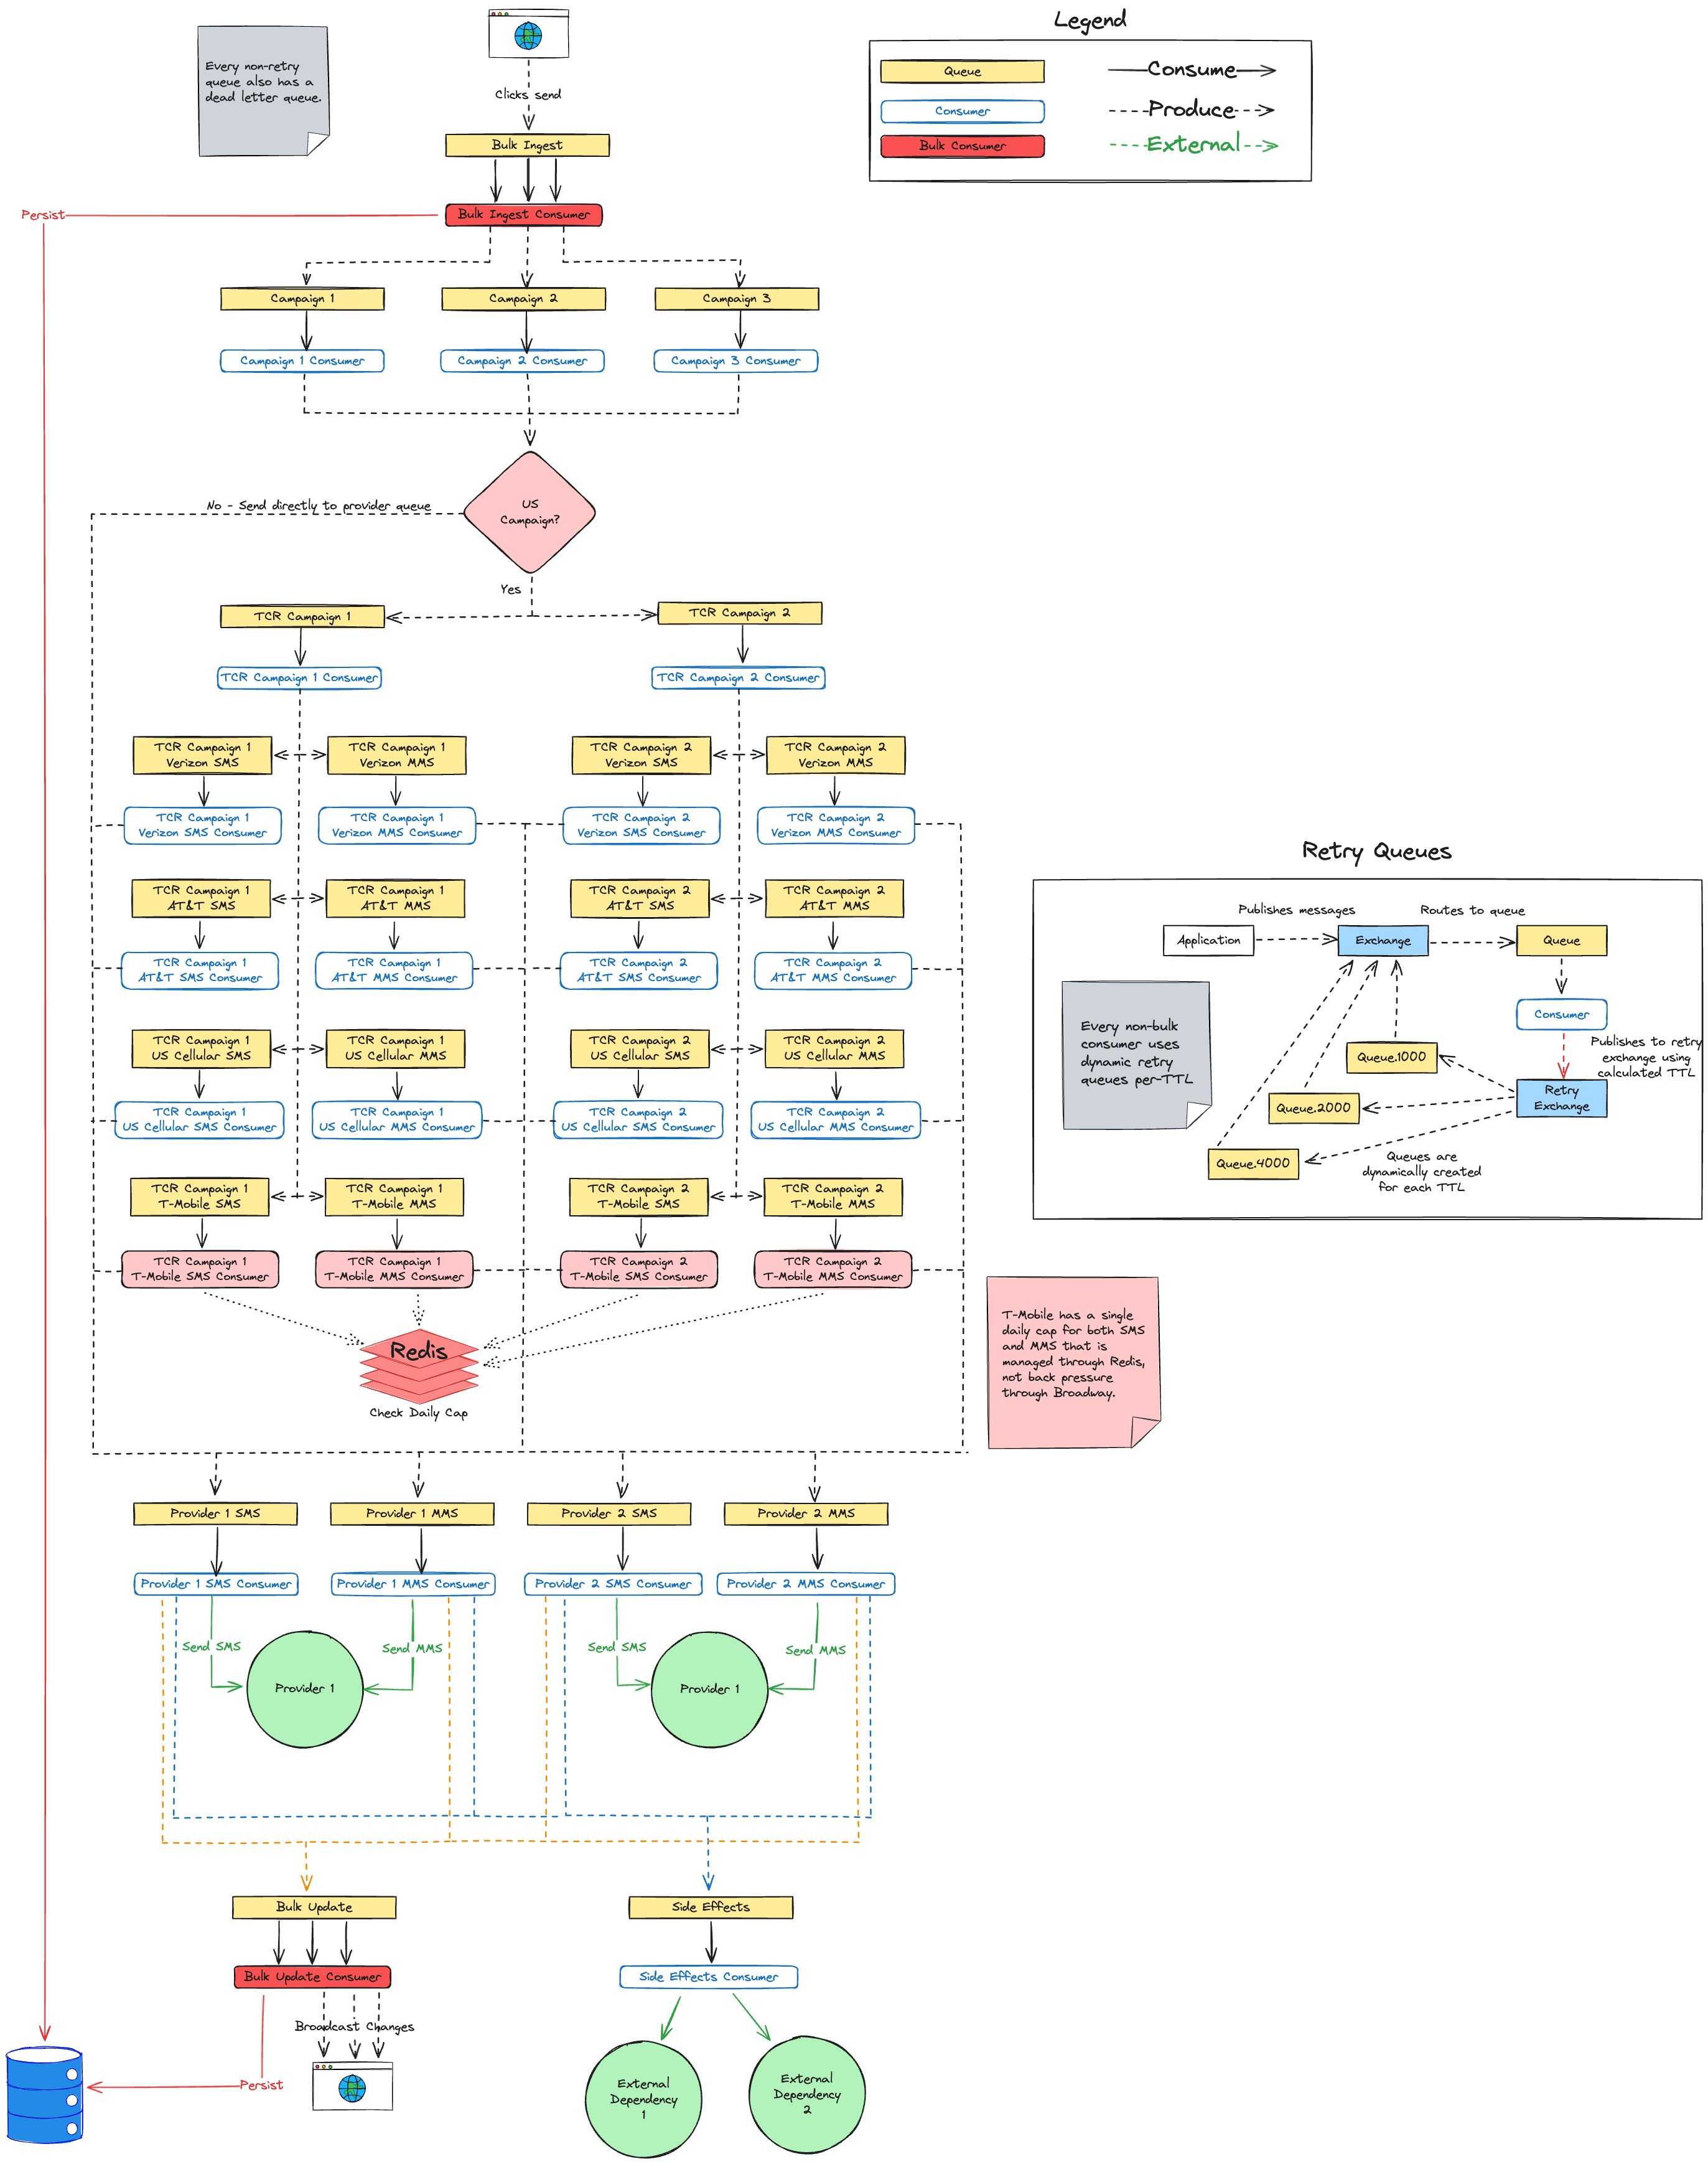
Lessen load on DB
Separation of concerns (rate limiting and business logic)
Respect all provider rate limits
Respect all TCR rate limits
Intelligent retries
Observability
Batch sending
Scheduled sending
Any questions?
Notes:
So, this is it. I think we’ve checked off all the requirements here. Let’s ship it.
Any questions? Does everybody feel like they understand the system just from this diagram? Maybe we should talk through it together to make sure.

Slide 15
Notes:
A huge chunk of that diagram relies on a basic understanding of RabbitMQ concepts, so let’s get started with a very high level overview of terminology around RabbitMQ.

Slide 16
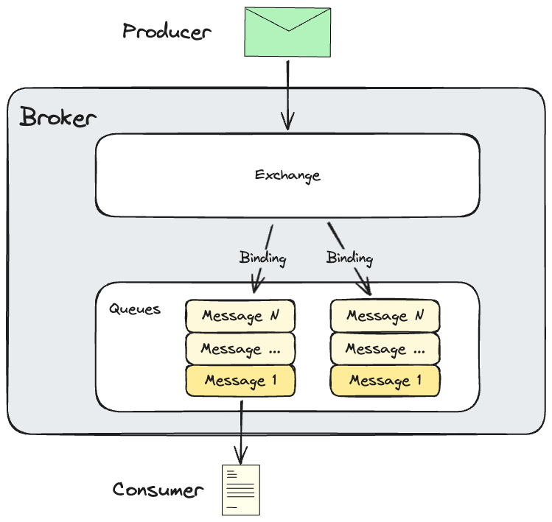
Notes:
This diagram gives a conceptual overview of Rabbit. First, the Rabbit server itself is the broker. A producer is part of your application code that produces messages to send to RabbitMQ. Those messages get sent to an exchange. The exchange is responsible for routing those messages to queues. Importantly, the outside world does not send messages directly to queues. The outside world knows about an exchange, which then routes the messages to a queue.
It knows how to route those messages based on the exchange type and bindings. A binding defines how a given exchange should route incoming messages to queues.
Our message bodies our JSON, but Rabbit is happy to use ProtoBuf, MessagePack, or whatever else your heart desires. Rabbit doesn’t care. For us, we like being able to peek into our queues to see messages during debugging, so we’re sticking with JSON.
Finally, your application creates consumers. Consumers connect to RabbitMQ and consume messages from a queue. Importantly, a consumer can also be a producer. As we'll see, this is the case for most of our consumers.
For the rest of this talk, I’m going to shortcut things by talking about sending messages to queues. Just be aware that is hand waving over a bit more complexity than that. We don’t have any complicated routing rules in our system, so that shouldn’t cause any large headaches.
Rabbit is also very configurable. We leaned into resiliency at the expense of optimal scalability for now, by making our queues persistent to disk and highly available across nodes in our Rabbit cluster. In our use case, losing messages is not acceptable. In your use case that may not be true. Rabbit can be configured for either.
This talk is meant to be a case study of a system using RabbitMQ, not a deep dive into Rabbit itself, so let’s move on to the pipeline.

Slide 17
Bulk Ingest Stage
Notes:
Our pipeline starts when a user clicks a button to send a message. We want to make sure that messages gets into our database up front. Our legacy system did this too, but it did it immediately for every single message. The user clicked the button to send the message and we immediately persisted that message to our DB. Only after that did we enqueue a Verk job. One of our goals in the new system was to lessen the load on the DB. This was a prime opportunity to do that.

Slide 18
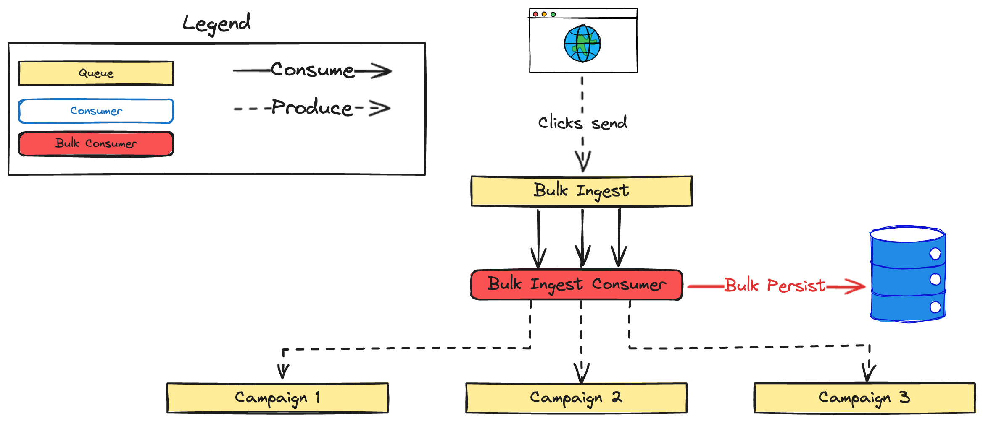
Notes:
Hence, bulk ingest. Instead of persisting each message individually, we’re going to persist them in batches with bulk insert operations. This will lessen the number of roundtrips to the DB. The raw number of records getting inserted is the same, but we’re batching together into more efficient transactions.
In this diagram we can see that a user clicks the button to send a message. This enqueues a message in our bulk ingest queue. From there we have configured a Broadway consumer to consume messages from the queue in batches. The consumer then processes all the messages in that batch at once and bulk persists the DB changes in as few roundtrips as possible. This includes persisting the new message, updating the status of the conversation that message is part of, and some other miscellaneous pieces of bookkeeping for business rules.
After all of that data is persisted, each message is sent along to the queue for the correct campaign. We’ll go over what a campaign is soon.

Slide 19

Batch Sizes
Notes:
Broadway allows us to configure both the size of the batch and the timeout. If not enough messages come in to fill the entire batch before the batch timeout, Broadway will send a smaller batch to the consumer. For example, if batch size is 50 with a timeout of 100ms, then if there are only 25 messages after 100ms, those 25 messages will be sent to the consumer as a single batch.
Getting the proper batch size has been more art than science so far. We’re going to continue to refine this more.

Slide 20

Lesson Learned
Pipeline Message Struct
Notes:
One mistake we made in our initial implementation was to tie our message payload structure to our DB schema. This had a couple of issues.
First, it tightly coupled our messages to our DB schema. Any change to our DB schema risked changing the shape of messages in our pipeline. This was brittle and made versioning of the messages difficult.
Second, it increased the size of our payload. We were passing around a bunch of data that is important in our schema, but not important for sending messages.
Luckily, we were able to fix this. Making this kind of fix is way easier before going live. It would have been way harder to make this change after going live. We would have needed to support both message structures for some period of time until all the old messages had flowed out of the system.
Proper versioning of changes to our pipeline message struct is still something we have to manage, but being able to make those changes independently of our DB schema is huge.
Bulk ingest is the point where the transformation happens. Messages are built using our DB schema and then sent to bulk ingest. Bulk ingest persists these to the DB and then transforms them into a pipeline message for all subsequent stages in the pipeline.

Slide 21
Requirements
Lessen load on DB (partially)
Separation of concerns (rate limiting and business logic)
Respect all provider rate limits
Respect all TCR rate limits
Intelligent retries
Observability
Batch sending
Scheduled sending
Notes:
This partially checks off our first requirement. We’ll see at the end of the pipeline that we do some similar batching for updates after the message was sent out. I’m going to go ahead and cross it off here though even though we’ve only done it partially.
I’m not going to check this one off yet, but this also gets a long ways towards batch sending. Currently, all of our messages come from a user clicking a button, but that doesn’t have to be the case. Some other event in the system could easily queue up thousands of messages. Our bulk ingest stage is setup to support that without stressing the DB too much.
This is a big point for doing as little work up front when the user clicks the button to send a message. By pushing persisting the data into the bulk ingest stage of the pipeline, we make it easier to add other ways of sending messages in the future.

Slide 22
Campaign Stage
Notes:
Let's move on to the next stage in our pipeline. Our customers send messages as part of what we call "campaigns" in our domain. A user creates a campaign and adds a list of contacts to it. When a campaign is launched, we attach a phone number from one of our providers to it that will be used to send the message. All messages for a single campaign will be sent through one provider.
It looks roughly like this

Slide 23
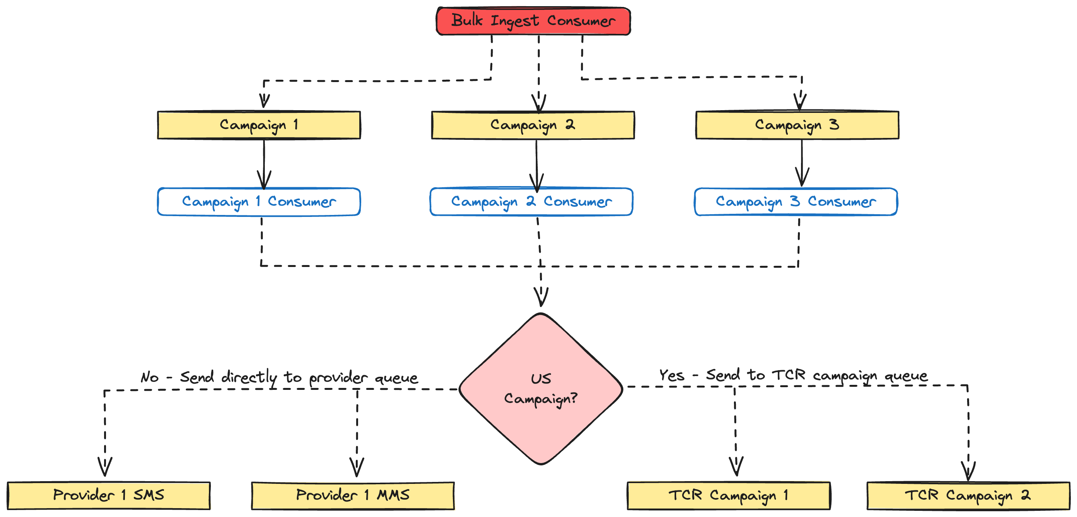
Notes:
We saw the top of this diagram before. The bulk ingest consumer has a batch of messages. Once it has persisted information about the text messages to send out to our DB, it produces new messages that will be routed to the appropriate queue for the GetThru campaign. Note that the bulk ingest consumer is also a producer. That is common throughout our pipeline. Each consumer consumes messages from Rabbit and then produces a new message to send to the next stage in the pipeline.
Each campaign gets its own queue and consumer. When a campaign is launched, we dynamically create a queue in RabbitMQ for that campaign.
In addition to the GetThru campaign queue, we’re also going to dynamically start a Broadway consumer process. That process will then start consuming messages from the corresponding GetThru campaign queue.
Most of our pipeline stages are very simple. The campaign stage exists purely to check if the campaign is in the US, and, if so, that the TCR campaign is properly configured. If the campaign is not in the US, then it is not subject to TCR and we can send messages directly to our provider queues so we can send a text message. If the campaign is in the US though and we confirm that it is properly configured, then we send it to the correct TCR campaign queue.
Our customers can have multiple GetThru campaigns at one time, but often times those campaigns are going to share the same TCR campaign. For example, both campaigns 2 and 3 could be subject to TCR and both use TCR Campaign 2.

Slide 24
Send Message Stage
Notes:
Let’s go down the simple path for non-US campaigns first. These aren’t subject to TCR, so we can push messages directly to our Send Message Stage. This is where we make an API to one of our providers to send a text message.

Slide 25
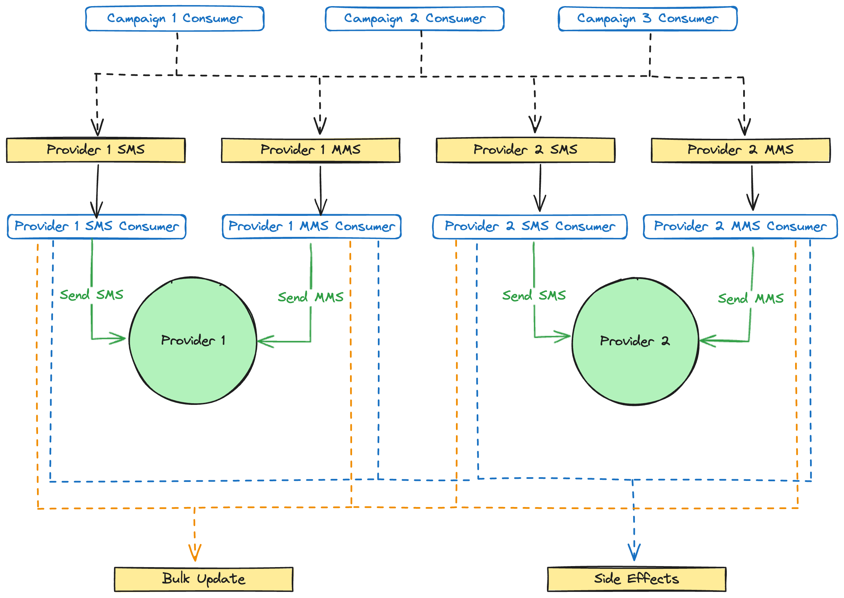
Notes:
All of these campaigns are non-US, so the consumers publish their messages directly to the provider queue for the campaign. There are separate queues for both SMS and MMS messages for each provider. This is because each provider has a separate rate limit for how many SMS and MMS messages you can send in a window. For example, a provider may allow you to send 500 SMS messages per minute, but only 250 MMS messages per minute.
Assuming a consumer can successfully send an SMS or MMS to the provider, we then publish two Rabbit messages. One will go to a bulk update queue and the other will go to a side effects queue. You can see that the orange lines go from each consumer to the bulk update queue and the blue lines from each consumer to the side effects queue.
Importantly, just because a provider has accepted our API request to send an SMS or MMS does not guarantee it’s going to be delivered to somebody’s phone. There are a lot of things that could go wrong, but we don’t get immediate feedback on that. We have to wait for them to call a webhook in our system with information on message deliverability.
Now, I mentioned provider rate limits. Each provider limits how many SMS and MMS messages we can send in a window. Remember that one of requirements was to have a clean separation of concerns between rate limiting and business logic, and the way we do that is through back-pressure

Slide 26
Broadway & Back Pressure
Notes:
Back-pressure is the concept of a consumer telling a producer or source of events how many it wants at a time. Rabbit has no concept of rate limiting or back-pressure. Instead, we configure it in Broadway. Let's walk through some examples.

Slide 27
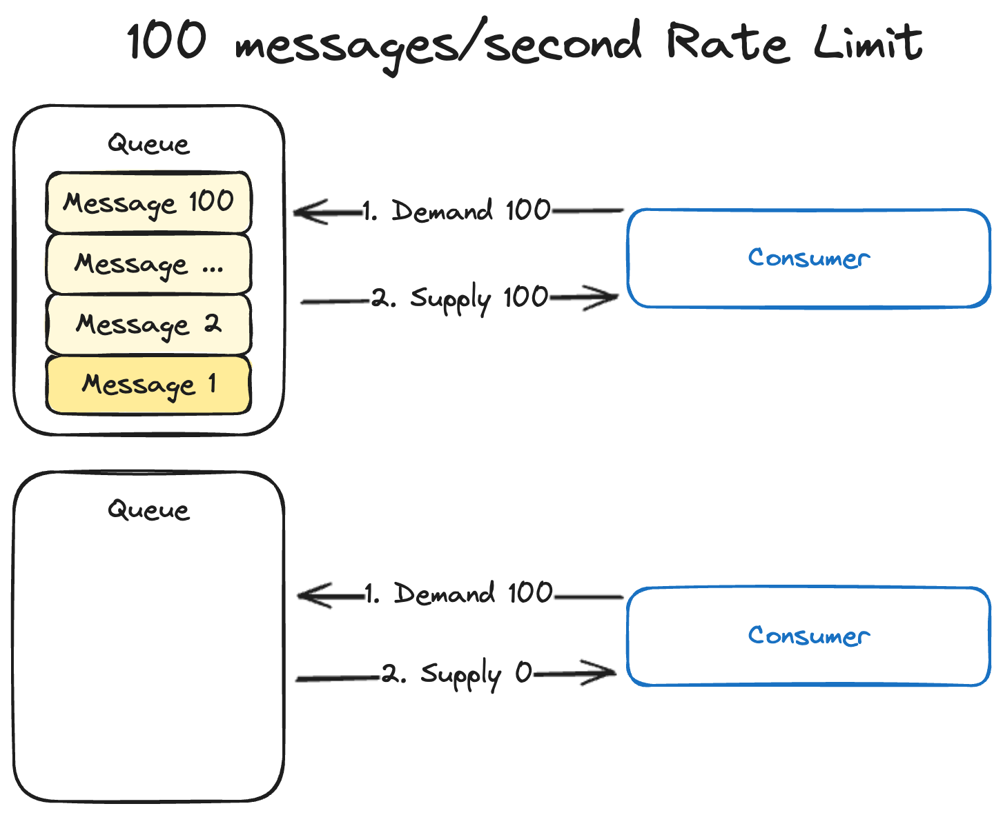
Notes:
Let's say our provider is rate limiting us to 100 SMS messages/second. We have a consumer that is going to make the API call to the provider to actually send the SMS. We configure that consumer to demand 100 messages/second from a Rabbit queue. In this case we can see that we demand 100 messages. The queue conveniently has exactly 100 of them, so it supplies 100.
One second later the consumer will demand another 100, but now the queue is empty so 0 get supplied.

Slide 28
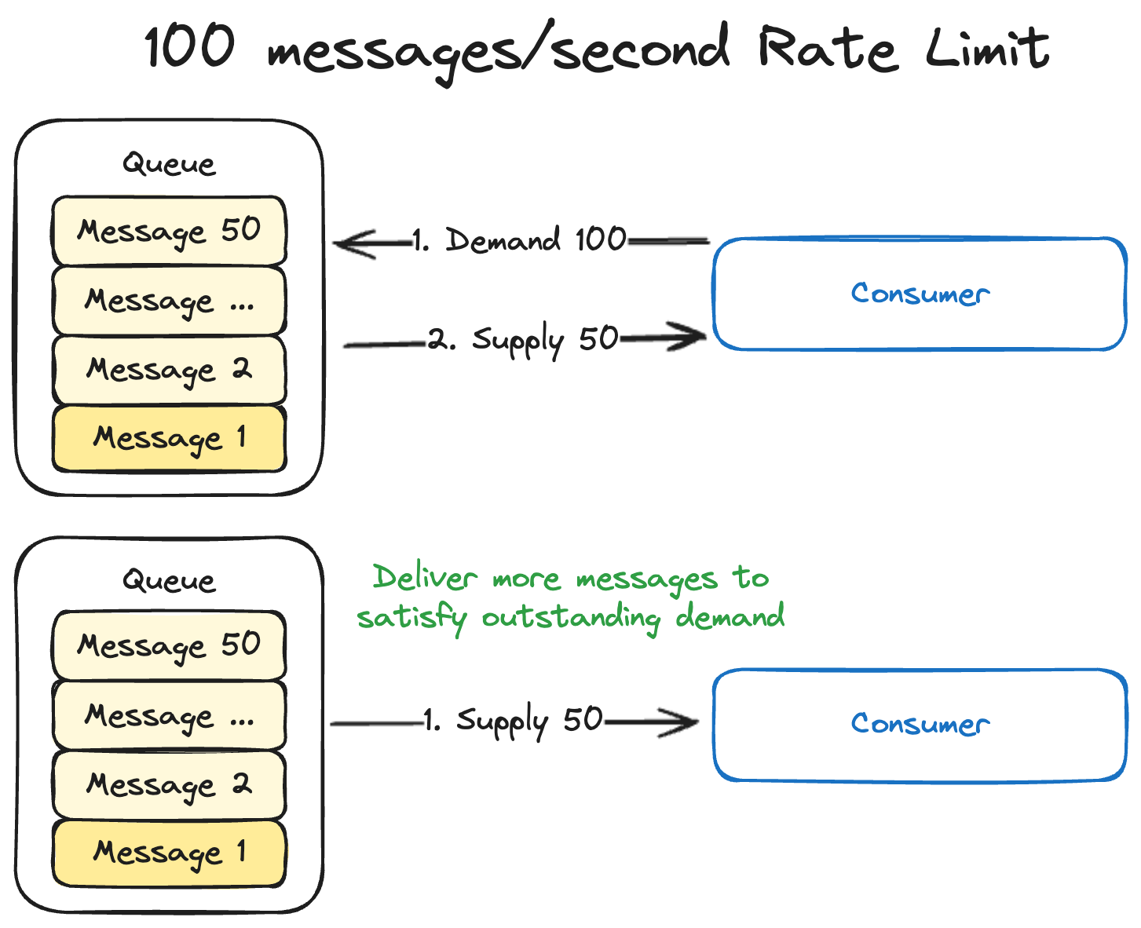
Notes:
But what if there aren't enough messages in the queue to satisfy the demand to begin with. In this case we demand 100, but the queue only has 50. Those get supplied to the consumer.
But what if another 50 messages get added to the queue before the rate limit window expires? Rabbit will push those 50 messages to the consumer to satisfy the demand.

Slide 29
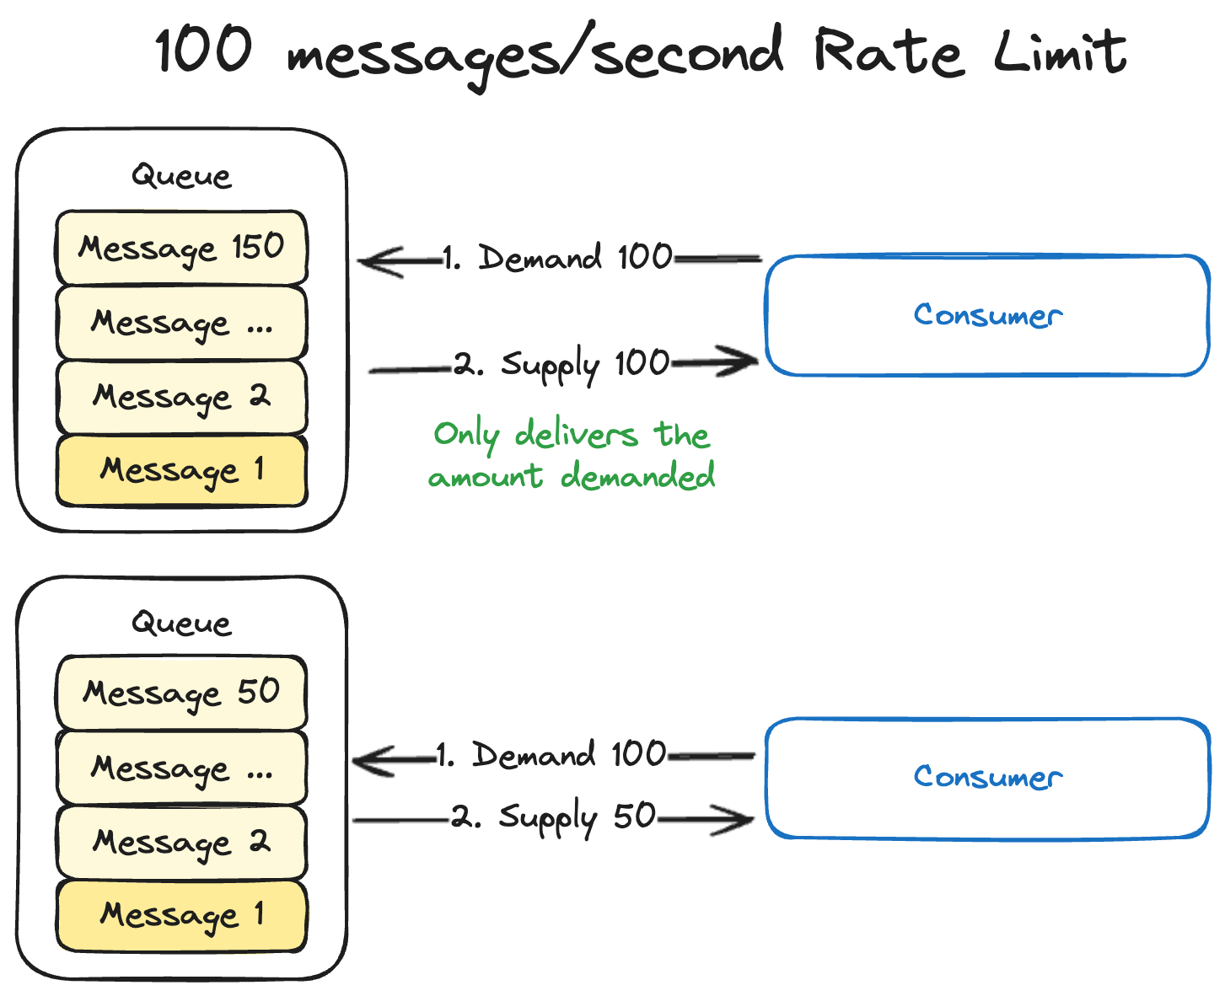
Notes:
And finally, what if there are too many messages in the queue. In this example, the queue has 150 messages, but our rate limit is still 100/second. The consumer demands 100 and is immediately supplied with 100. The consumer processes all of those and then demands another 100 in the next second. There are only 50 to supply this time, which puts us in the same situation as the last example.
These examples all show one consumer with one processor, but you can configure Broadway to use multiple processors per consumer as well. Maybe you have so many messages coming in that one processor can't keep up. This kind of concurrency is Elixir's bread and butter and Broadway makes it simple.
There is a lot more you can do with Broadway, but this is a reasonable enough simplified explanation of back-pressure for our purposes.
Our consumers are all configured to use one processor with a rate limit equal to the provider’s rate limit for that message type. If our provider has a rate limit of 250 MMS/second and we configure our rate limit in Broadway to the same, then back-pressure ensures that we will never exceed our provider rate limit.
Messages may pile up in the Rabbit queue, but that is a different problem. Attempting to process more messages isn't going to solve the problem of the provider rate limit being too low in that case.

Slide 30
Requirements
Lessen load on DB (partially)
Separation of concerns (rate limiting and business logic)
Respect all provider rate limits
Respect all TCR rate limits
Intelligent retries
Observability
Batch sending
Scheduled sending
Notes:
This checks off another one of our requirements, separation of concerns. We rate limit API calls to our providers purely through configuration. When the consumer processes messages from the queue it can focus purely on business logic.

Slide 31
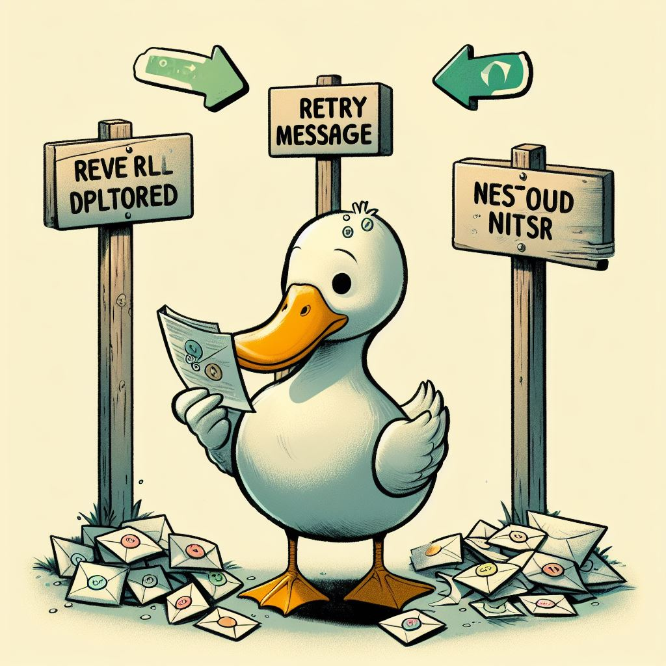
Retry Strategy
Notes:
That doesn't mean things can't still go wrong though. We still need to be able to retry messages. The provider may be down. There could be bugs in our code. Depending on the scenario, we may want to retry.
A good retry strategy is trickier than you would think in RabbitMQ. We based our strategy on an article by Brian Storti.
There are three simple ways to handle failures in Rabbit: discard the message, requeue it, or send it to a dead-letter exchange. Discarding messages is not acceptable in our scenario. That would mean our client's text message is never sent.

Slide 32
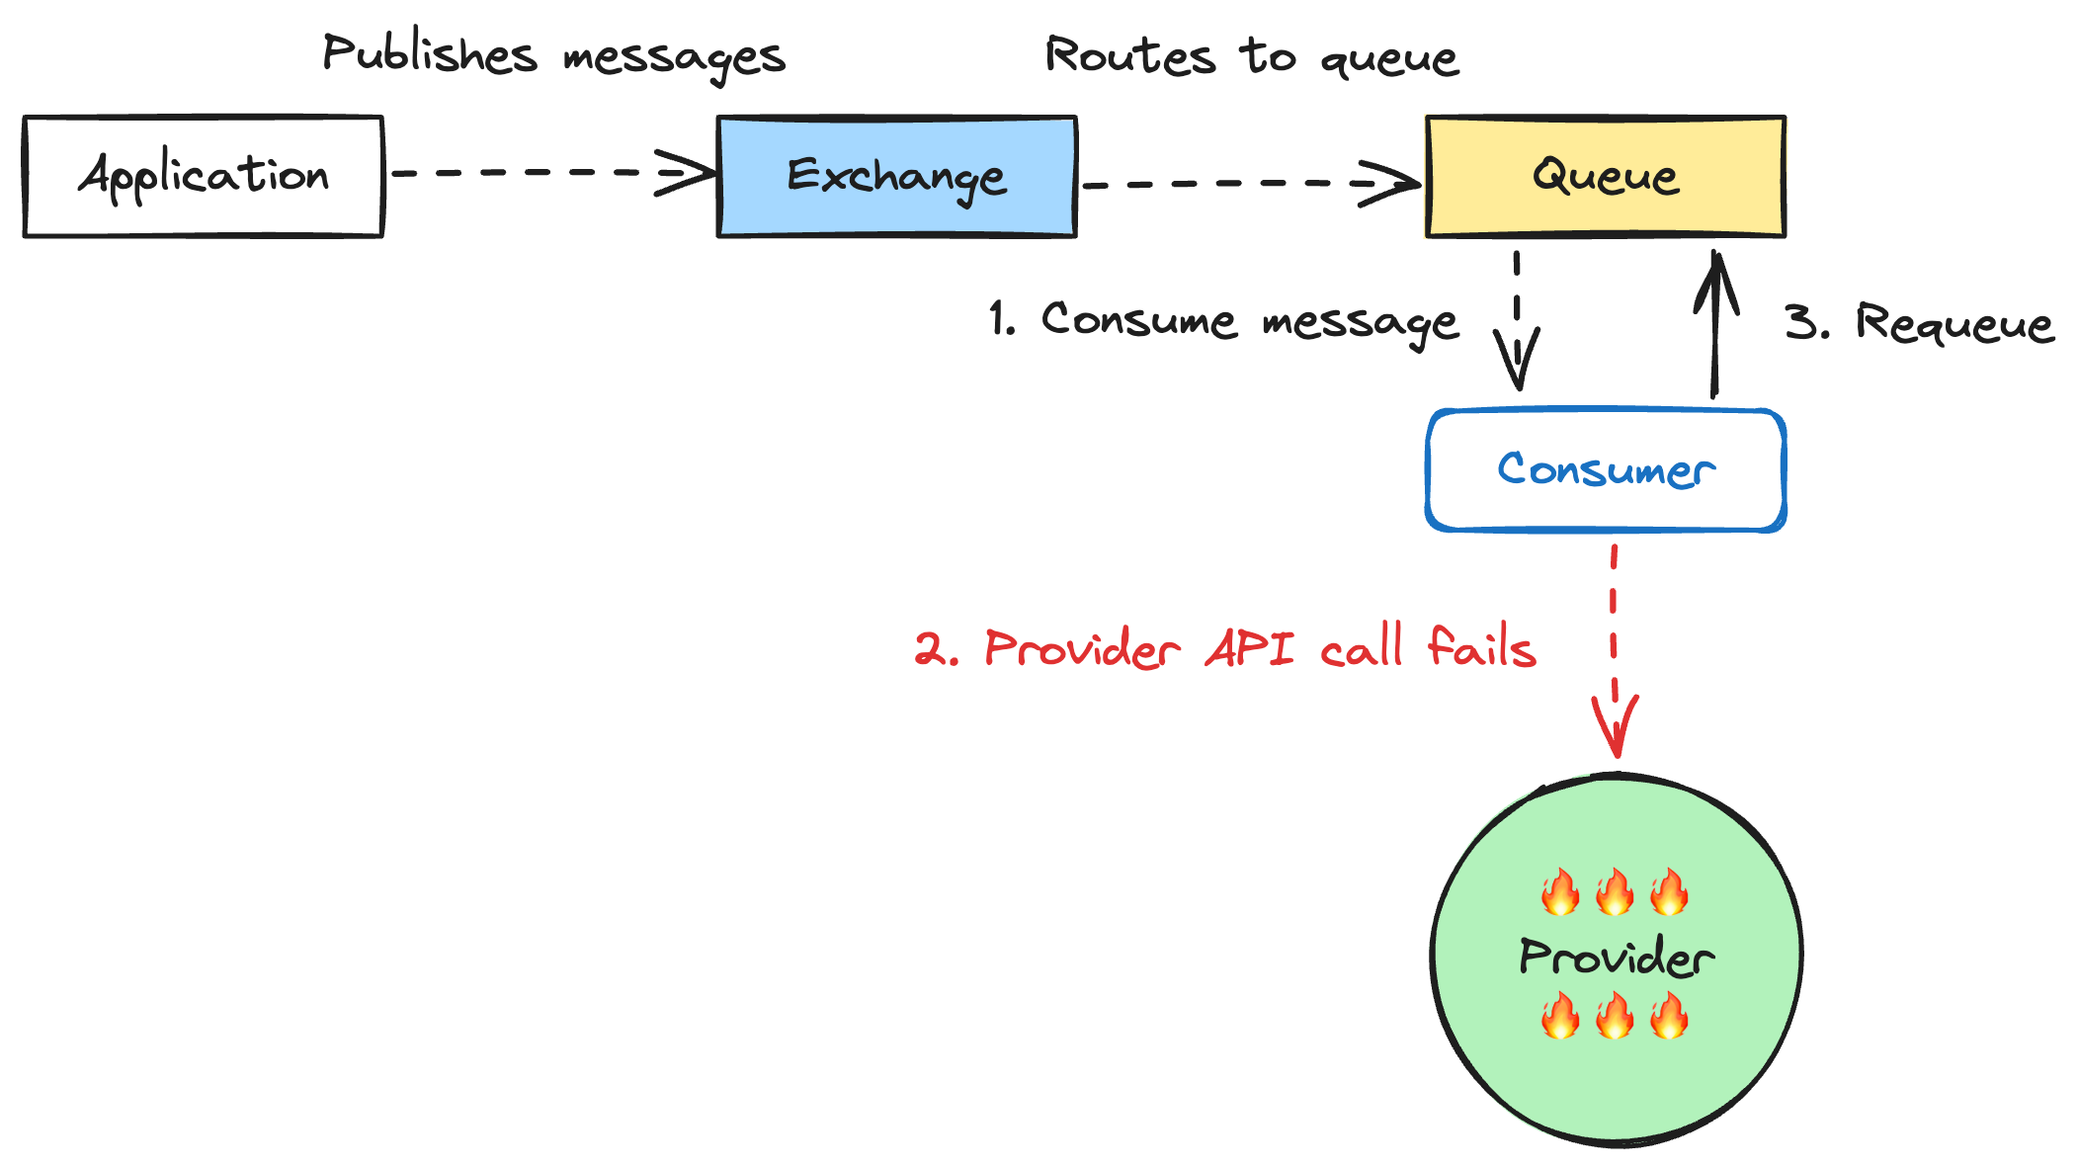
Notes:
Requeuing is also a non-starter. If our provider is down, then just requeuing the message will just send it again as soon as it comes back to the front of the queue. We're just going to spam the provider even though their system is down. So, that one is out too.
In fact, this is exactly the problem we ran into with our old system. We’ve had situations where we spam retries. It’s a pretty helpless feeling to see it happening in production and not having good tooling to deal with it.

Slide 33
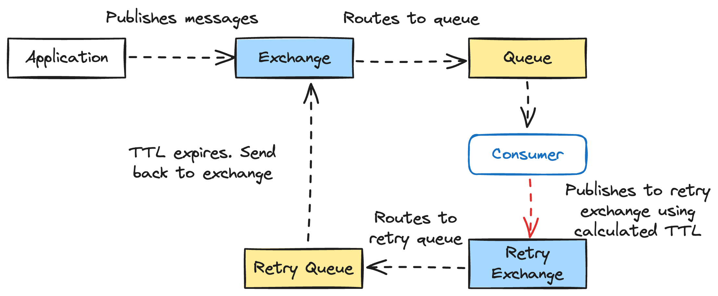
Notes:
That leaves us with dead-lettering. Initially, that seems promising. It's is a nice fallback, but requires knowing what to do with those failed messages. It you have one corresponding dead-letter queue for each queue in your system, then it can be difficult to automatically recover. You end up having to manually shovel messages from your dead-letter queue back to the working queue.
But what if we setup a retry exchange with a per-message time-to-live (TTL) and a DLX of the worker queue? When the message fails, we'll increment the number of times that particular message has failed to calculate the exponential backoff. Then we set that backoff as the TTL of the message in the retry queue. When the first message in a retry queue reaches it's TTL, it will be moved back to the worker queue for retry.

Slide 34
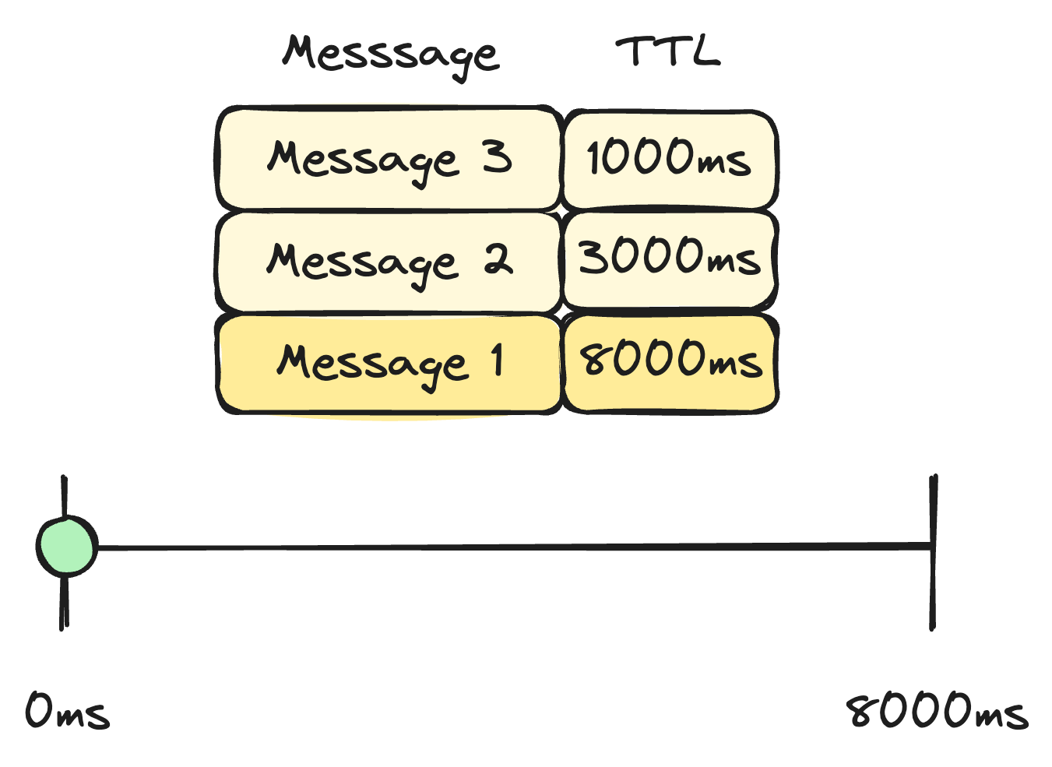
Notes:
This sounds great, but has a fatal flaw. Rabbit won't expire messages until they reach the front of the queue. Let’s look at an example. Here we have a retry queue that contains three messages. The first message in the queue has a TTL of 8000ms, the next one a TTL of 3000ms, and the last one a TTL of 1000.

Slide 35
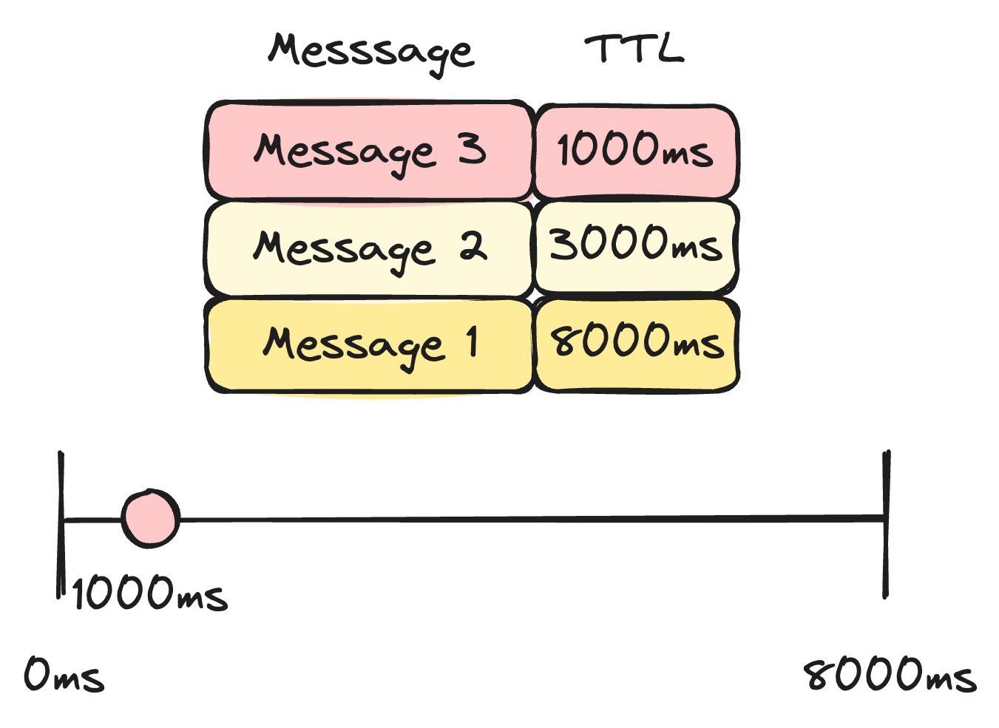
Notes:
At 1000ms the last message in the queue is at it’s TTL, but Rabbit can’t expire it yet. It’s not at the front of the queue and the front messge won’t expire until 8000ms have passed.

Slide 36
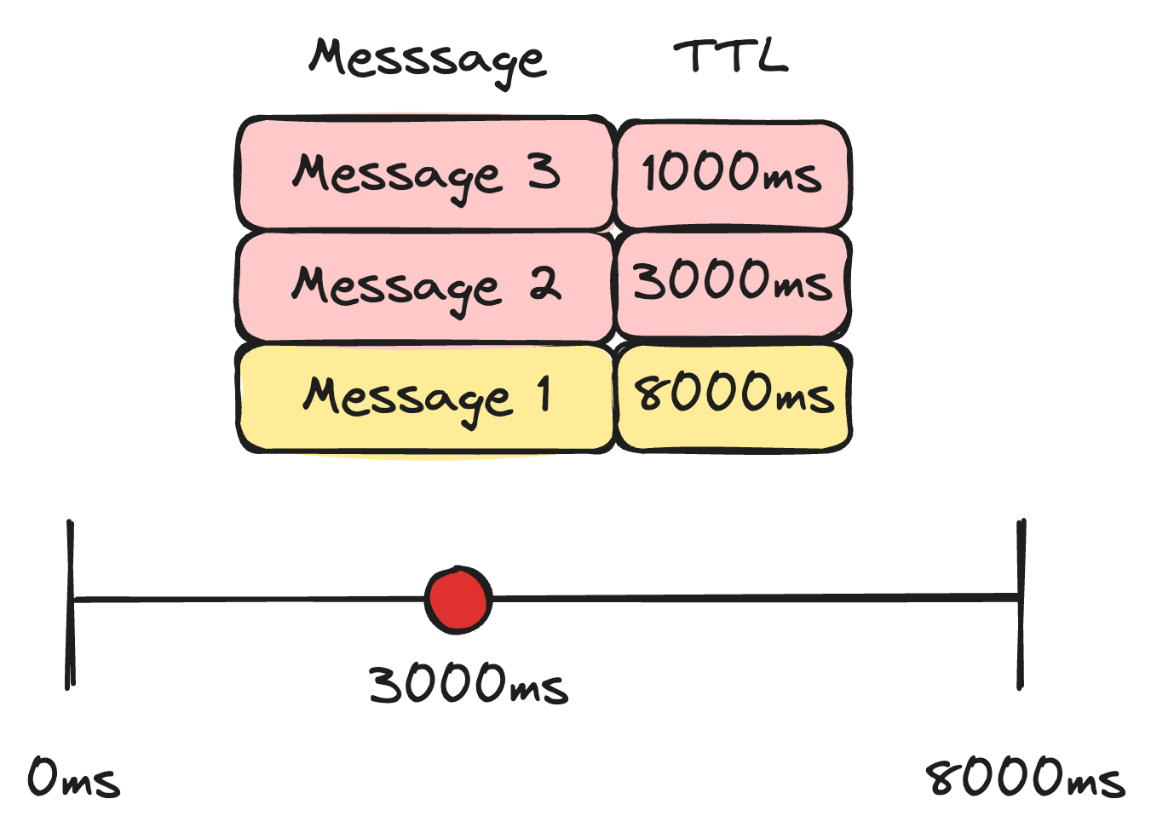
Notes:
At 3000ms the middle message in our queue expires, but it’s stuck too.

Slide 37
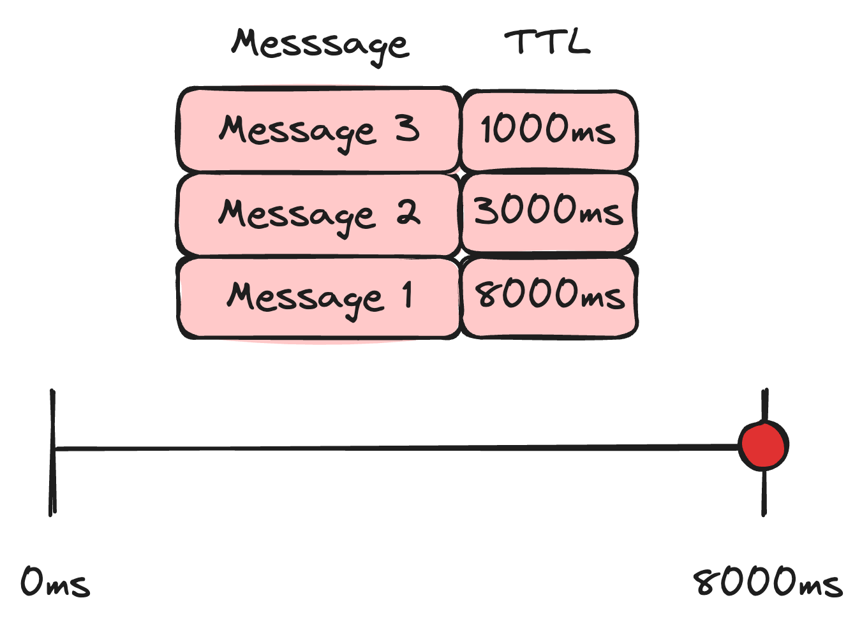
Notes:
Finally, at 8000ms the message at the front of the queue expires. This message will be sent back to the exchange. Then message 2 will come to the front. It’s already expired so it moves out right away. Same for the last message after that.
Every message in our queue effectively had a TTL of 8000ms because that was the TTL of the first message and it was the longest.

Slide 38
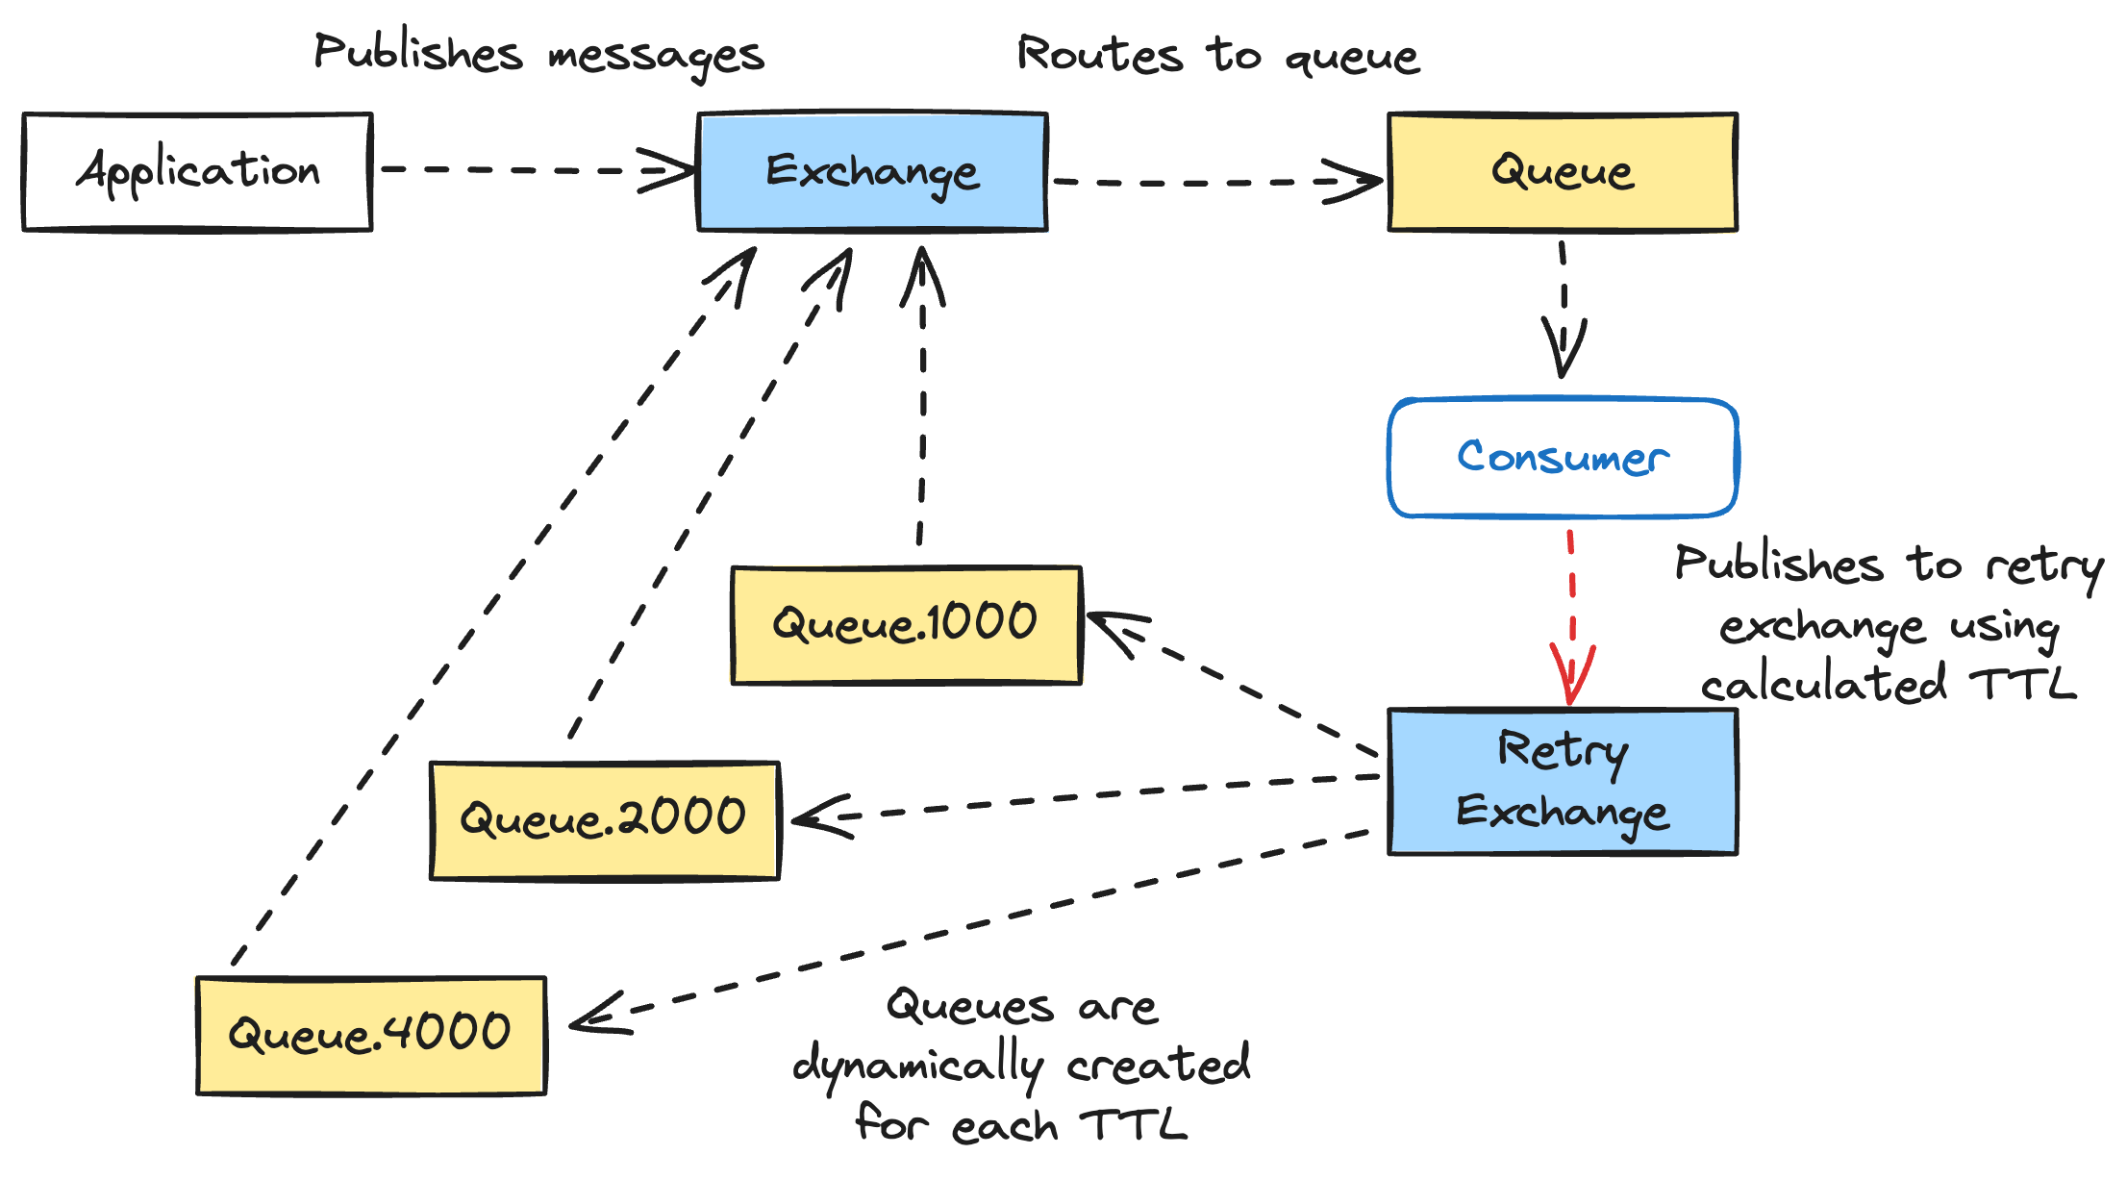
Notes:
The way to work around this is to setup retry queues per TTL. All messages on their first retry get sent to queue.1000. All messages on their second retry get send to the queue.2000, and so on. If every message in the queue has the same TTL, then they will expire in order. No messages will have a shorter TTL and get blocked by one in front.
Does anybody see a downside here with this? Has anybody implemented exponential backoff before? What is important to include in an exponential backoff algorithm? Yes, jitter. Jitter adds some randomness to your backoff to smear the retries across time to avoid a thundering herd. Because the TTL for each retry must end up in a queue for that retry amount, we lose the ability to add jitter to our backoff calculation. That is unfortunate, but a tradeoff we felt was worthwhile for what this gives us.

Slide 39
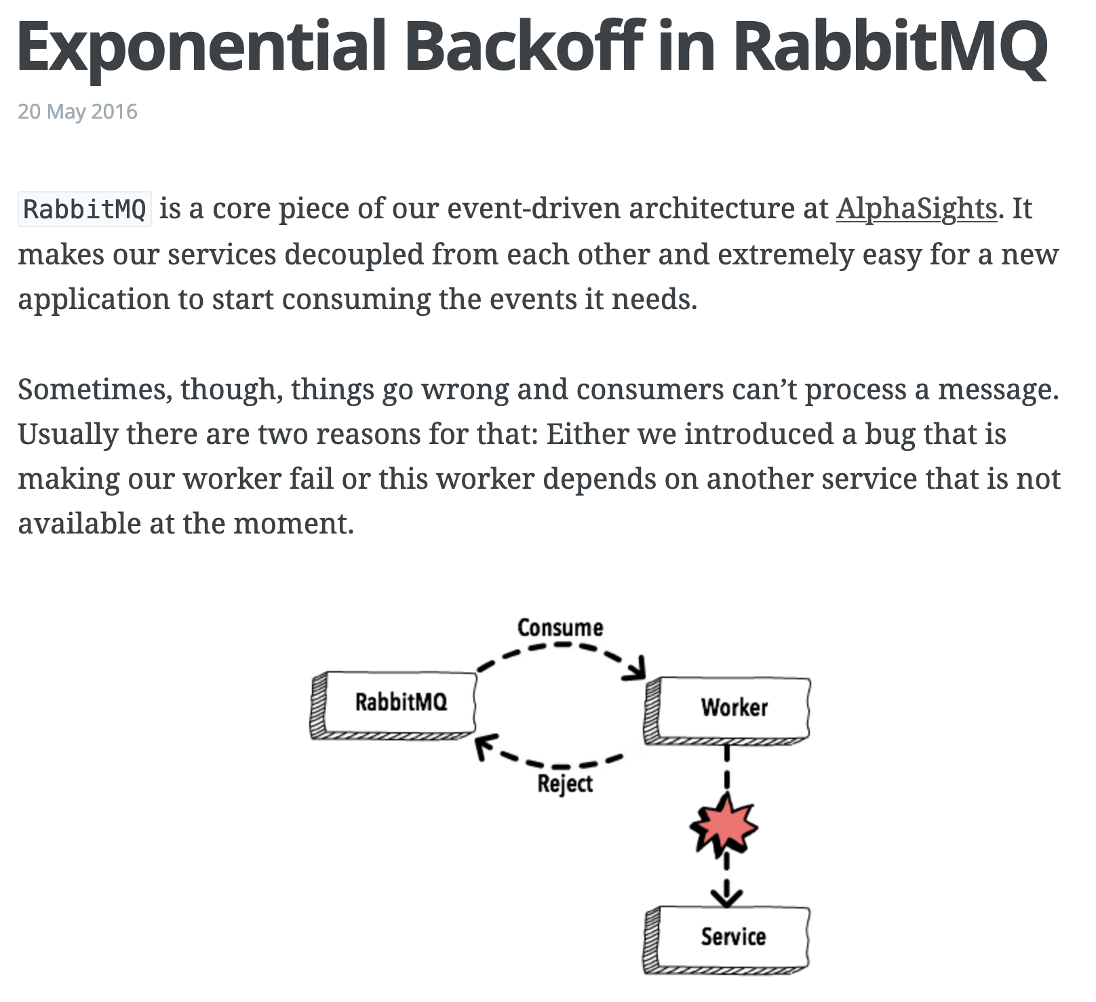

https://www.brianstorti.com/rabbitmq-exponential-backoff
Notes:
This is one of the most important things you can take away from this talk. If you're building an event or message-driven system with a lot of retries, then read this article. There is a good chance that's it's going spur a lot of excellent discussion about your architecture and domain. Even if this solution doesn't work for you, you're going to end up in a better place for having read it.

Slide 40

Lesson Learned
Retries Are Hard
Notes:
This retry queue setup solved a lot of problems for us, but it didn't come without complications. Besides the limitation of no jitter on our backoff, there is also a lot of dynamic queue creation going on.
This will become obvious as we continue to build up the pipeline for our domain, but we're going to end up with a lot of queues in this system. Almost all of these support retries. That means the potential for a lot of retry queues.
We still need to figure out over time how many retries makes sense for various stages in the pipeline and what the backoff should be. That’s going to take iteration over time in production

Slide 41
Requirements
Lessen load on DB (partially)
Separation of concerns (rate limiting and business logic)
Respect all provider rate limits
Respect all TCR rate limits
Intelligent retries
Observability
Batch sending
Scheduled sending
Notes:
This checks off two more requirements, respecting all provider rate limits and intelligent retries

Slide 42
Bulk Update Stage
Notes:
Now we’ve made an API call to a provider to send a text message, but we still need to update our DB to reflect that the message has been sent.
Bulk ingest helped with write performance when ingesting messages into our system. Creating a pipeline message struct specifically for passing through the pipeline helped with read performance as messages went through the pipeline. There was still one big win we wanted though. We wanted to bulk update messages at the end of the pipeline after the message was sent through a provider.

Slide 43
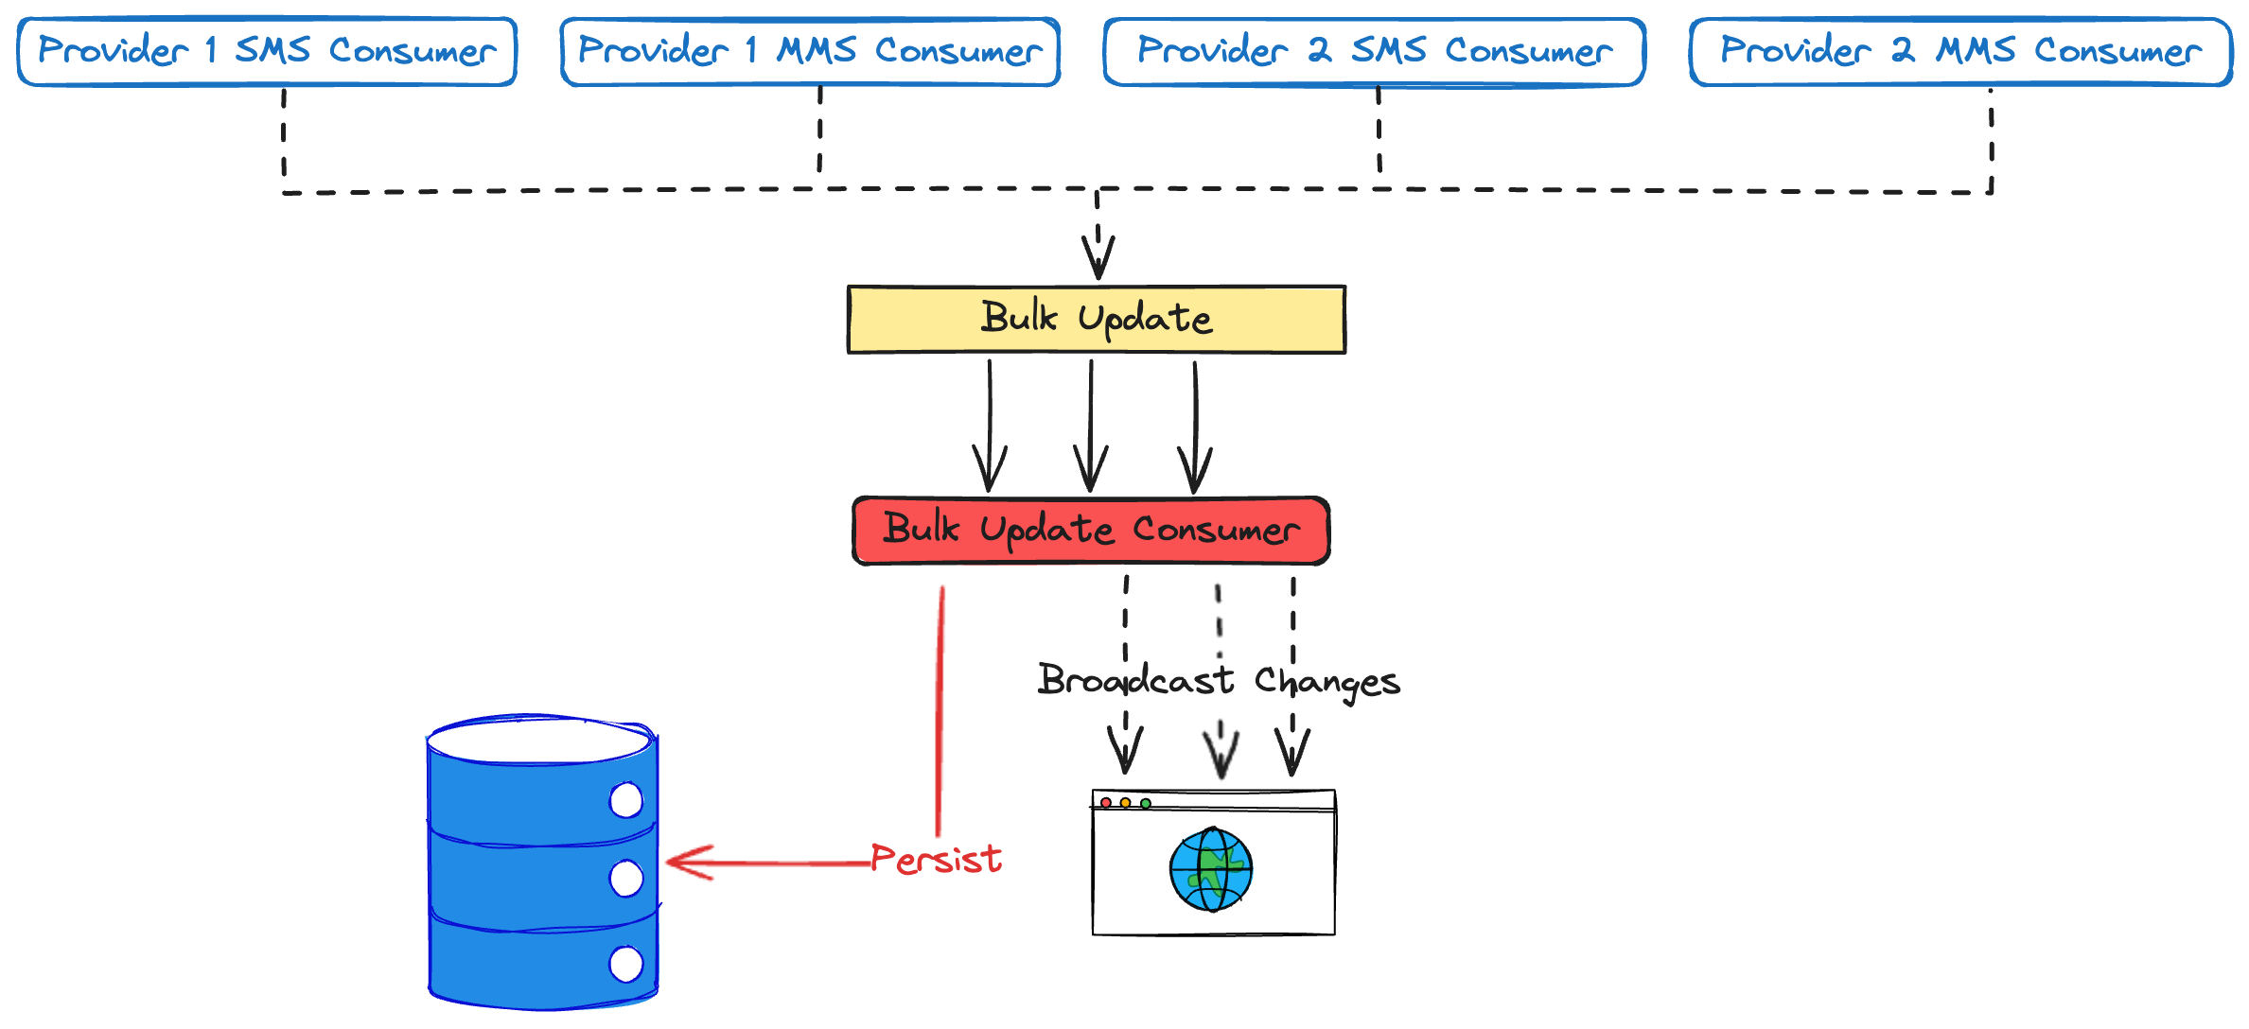
Notes:
To do that, we added a bulk update stage. It uses the same kind of batching we do for bulk ingest. There are a couple of wrinkles here though.
First, we need to update the DB whether we sent the text message or not. In some circumstances we need to update the message status to failed. Sometimes a message is never going to send. Maybe it's been too long. Maybe the client closed their campaign while the message was going through the pipeline. We need to persist those messages as failed.
Second, we need to broadcast that this message has been sent and its status updated in the DB. Maybe the UI needs to update in some way. Maybe some other system cares. In many other ecosystems, this would be another job for the message broker. That’s not necessary in Elixir. Elixir systems are made up of tiny processes that are actors. And in the actor model, actors send messages to each other. Using the Phoenix’s PubSub support, we can easily publish messages that other actors in the system can subscribe to. No extra message bus needed.
And this works across network boundaries. One node in our cluster could be processing messages in its bulk update consumer. An actor on another node can be notified transparently of this. And we get all of this pretty much for free because of the VM Elixir runs on, the BEAM.

Slide 44

Magic
Notes:
Getting this kind of power with such little effort feels like magic. Elixir often feels like forbidden alchemy.

Slide 45
Requirements
Lessen load on DB
Separation of concerns (rate limiting and business logic)
Respect all provider rate limits
Respect all TCR rate limits
Intelligent retries
Observability
Batch sending
Scheduled sending
Notes:
Earlier, we partially checked off lessening the load on the DB. The combination of bulk insert, bulk update, the pipeline message struct, and smart use of caches throughout stages should really lighten the load on our DB. I'm comfortable getting rid of the partially note on that requirement now.

Slide 46
Side Effects Stage
Notes:
Like most systems, there are side effects we want to happen when a message is sent. The PubSub in bulk update is certainly a side effect, but I’m talking about external side effects. For example, our clients might us to update a 3rd party system that they contacted a voter.
To accommodate this, we add one more stage to our pipeline. Details depend on the nature of the integration, but the general idea is outlined here

Slide 47
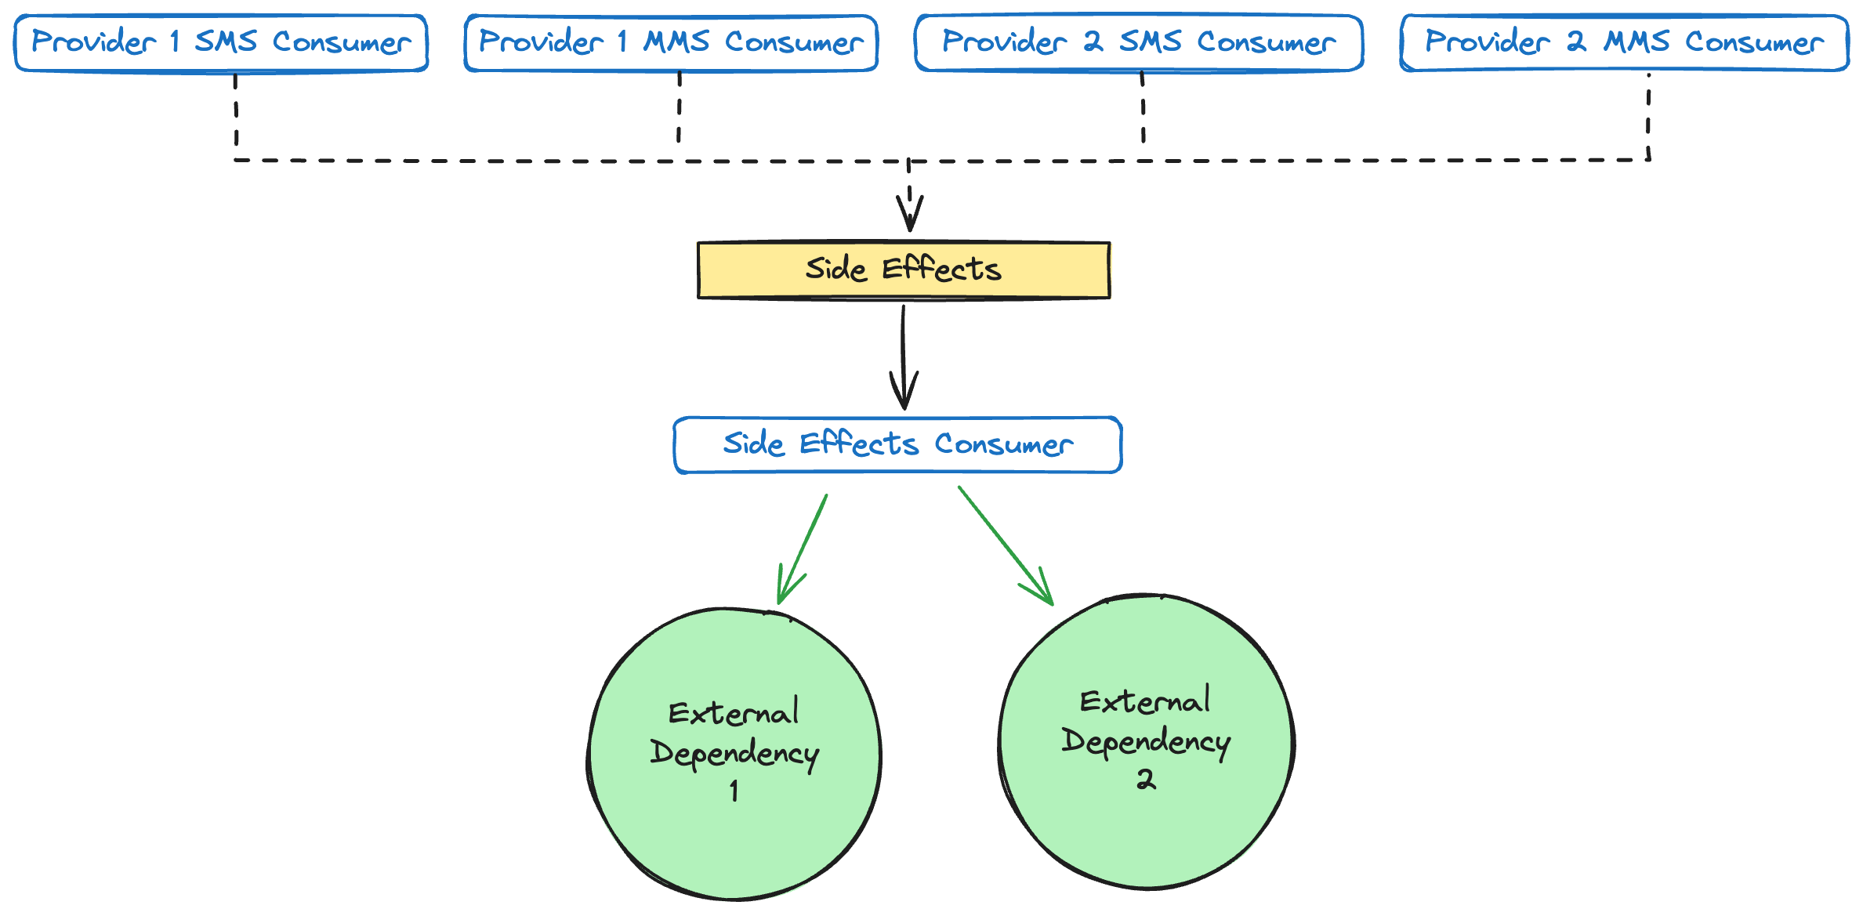
Notes:
The provider consumer now publishes two messages. It publishes to the bulk update queue as before, but now it also publishes to an outgoing side effects queue for the integration. Messages are consumed from side effects queue by a side effects consumer and processed.
Right now we have one queue and one consumer for all side effects, but we would like to split this into separate queues for each 3rd party integration. This will isolate failures when 3rd parties have issues and let us rate limit when necessary through back pressure per 3rd party integration.

Slide 48
😰
Notes:
That does it for our non-US customers. We see that their GetThru campaign is outside the US, send the text message through a provider while respecting their rate limits, update our DB and handle side effects.
But what about this big middle part of the diagram? This is where The Campaign Registry and carrier rate limits live.
Don’t let anybody tell you that you can’t use the tacky animations in Powerpoint. We have been given great power and what fun is it if you don’t abuse it on occasion.

Slide 49
Carrier Rate Limit Stage
Notes:
Remember that TCR is the carrier industry’s attempt at self-regulation of A2P text messaging. They want to allow A2P text messages (and profit from them) for various use cases, but keep them from being so annoying that the federal government steps in with regulation.
In practice, what this means is that we register a TCR campaign on behalf of our customers. TCR takes all the information about the campaign and spits back a vetting score. This vetting score determines how many SMS and MMS messages can be sent in a given interval.

Slide 50
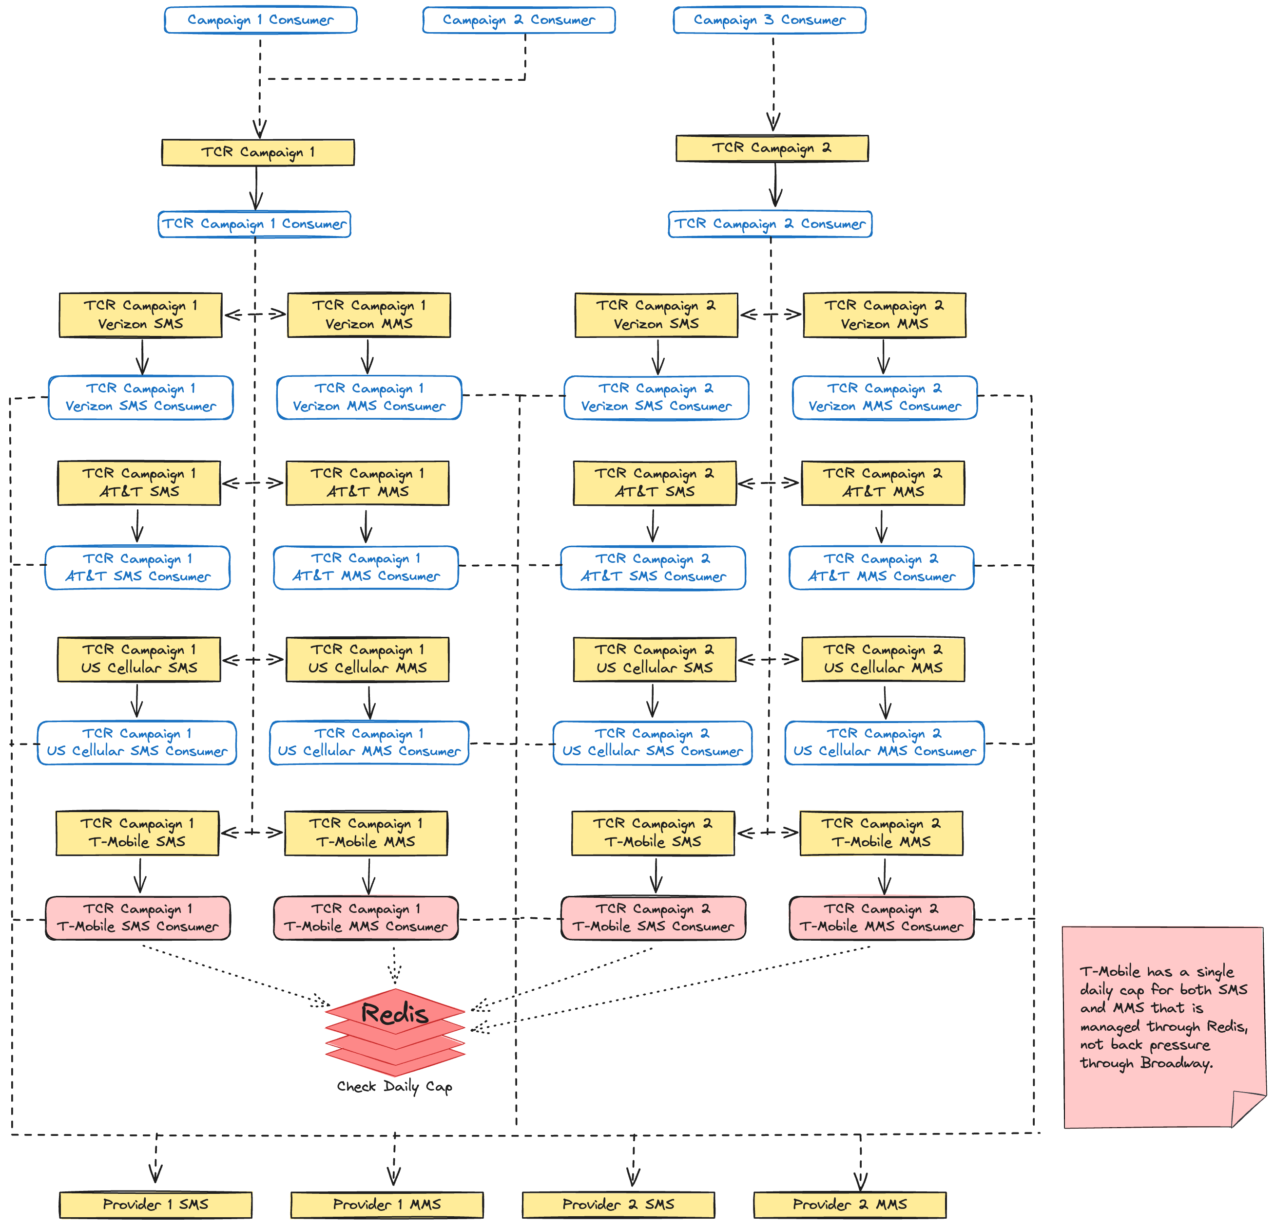
Notes:
And that brings up back to this scary looking part of our diagram. Starting at the top with our campaign consumers, let’s assume this campaign is in the US. That means it is subject to TCR, so we send a message to the TCR campaign for that GetThru campaign. Importantly, this is not a 1-to-1 relationship. There could be multiple GetThru campaigns for one TCR campaign. TCR has given us rate limits per carrier, so next the messages gets sent to the appropriate carrier queue for that TCR campaign.
This is still too much though, so let’s look at how it works for just AT&T

Slide 51
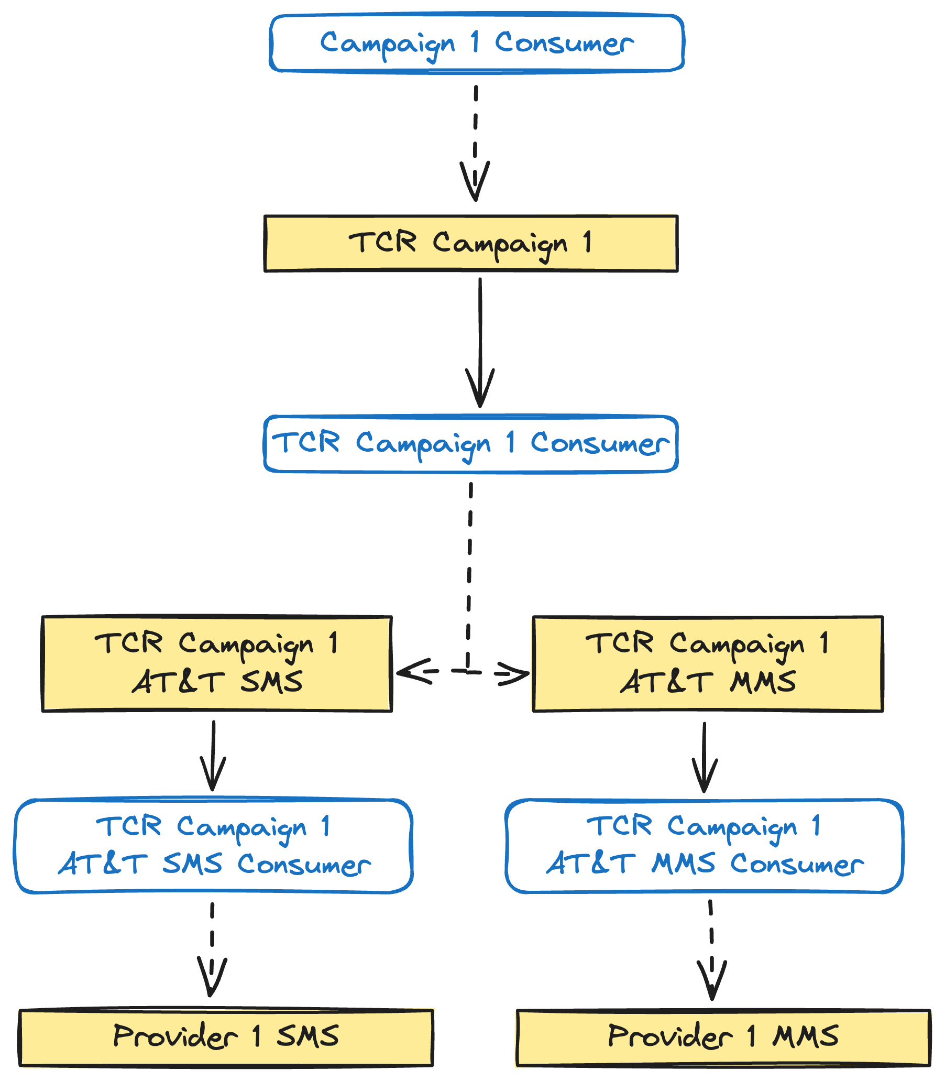

Notes:
We once against start with the campaign consumer, which determines the campaign is in the US. Then it gets passed to the TCR campaign queue. The consumer for that queue looks at the carrier the text message recipient is using and the type of message to forward it to the correct carrier queue for the campaign. For a SMS message to an AT&T phone number, we end up at the TCR Campaign 1 AT&T SMS queue.
The consumer for this queue pulls messages off while respecting the carrier rate limit we got from TCR. This is done once again using back pressure. If they say we can send 100 messages/minute, the consumer is going to have its rate limit set to 100 messages/minute. And that is all this consumer does. It exists to rate limit messages according the TCR rate limits we were given for that TCR campaign. It just forwards messages on to the correct provider queue.
Now, you might be asking what the point of the TCR campaign queue and consumer are. That’s a very good question.

Slide 52

Lesson Learned
Stages Are For Concurrency
and Back-Pressure
Notes:
They shouldn’t exist and we’re going to remove them. You should not add stages to your pipeline as a way of separating business logic or business concerns. They should only exist if you need to control concurrency and/or back-pressure separately for that stage.
The TCR campaign stage had been low key bothering me, but while preparing this talk I realized it had no reason to exist at all. This kind of separation is even called out as anti-pattern in the Broadway documentation.
But of course not every carrier can do everything the same way. What fun would that be?

Slide 53
T-Mobile Daily Caps
Notes:
Let’s talk about T-Mobile. T-Mobile has decided that their TCR caps are per day. No big deal, right? We can just use back-pressure with a really long window. No problem.
The issue is that deployments would bring down the app and reset the rate limit for the day. That’s not acceptable. We need that rate limit to be respected for the entire day no matter how many deployments we do or how many nodes come up or down in our system. It’s not a big deal if we have per minute or per second rate limit and the Broadway consumer gets restarted. In the next minute or second everything will be fine again. That doesn’t work when the rate limit window is an entire day.

Slide 54
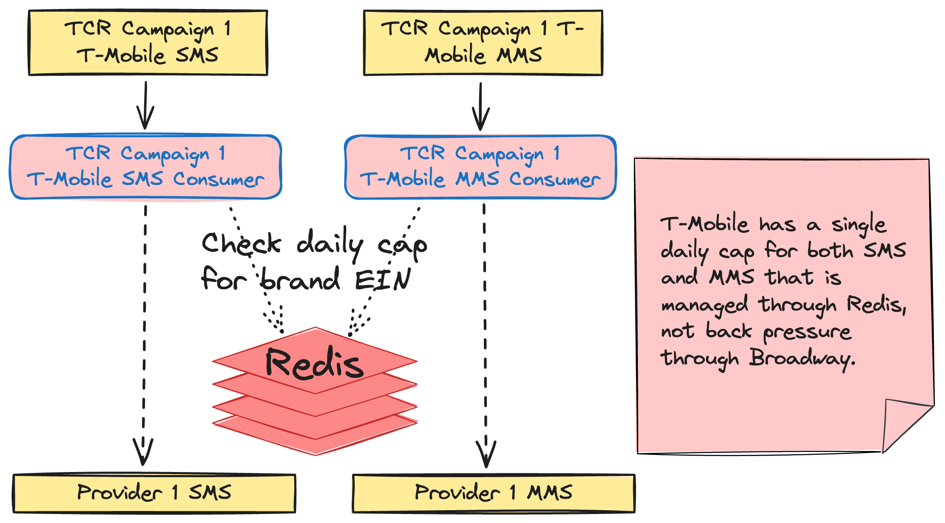
Notes:
This shows the TCR campaign queues and consumers for T-Mobile. Instead of using Broadway back-pressure, we instead rely on persistent counters in Redis. And T-Mobile has one more curveball for us too. They rate limit by the TCR campaign brand’s Employer Identification Number, the EIN. So, we keep track of how many messages have been sent for that brand EIN for the day in Redis. Every node in our cluster checks the same key in Redis for that brand's EIN.
If we haven’t hit the limit yet, the message can be forwarded to the correct provider queue. If we have hit the limit, then it needs to be sent to a retry queue. We talked about retry queues in the context of providers, but the same retry strategy applies to all of these carrier consumers as well.

Slide 55

Lesson Learned
Different Retry Strategies
Notes:
And that brings us to another lesson learned. We’re pretty happy with our dynamic retry queue strategy, but it isn’t appropriate in all cases. T-Mobile is one of those. When we hit the daily cap for T-Mobile, we know exactly when we can retry that message again. It’s whenever the campaign opens the next day. But our strategy of exponential backoff with dynamic retry queues doesn’t know that. We end up retrying messages that we know with 100% confidence cannot be sent until the next day. This isn’t a huge deal, but is wasted work.
We haven’t fixed this yet, but we should be able to calculate the TTL of the message in the retry queue so that it expires when the message is eligible to be sent again. Since they’ll all be eligible again at the same time, they all end up expiring at the same time, avoiding the issue of messages expiring out of order that our dynamic retry strategy is designed to avoid.

Slide 56
Requirements
Lessen load on DB
Separation of concerns (rate limiting and business logic)
Respect all provider rate limits
Respect all TCR rate limits
Intelligent retries
Observability
Batch sending
Scheduled sending
Notes:
And now we’ve satisfied our requirement to respect all TCR rate limits as well.

Slide 57
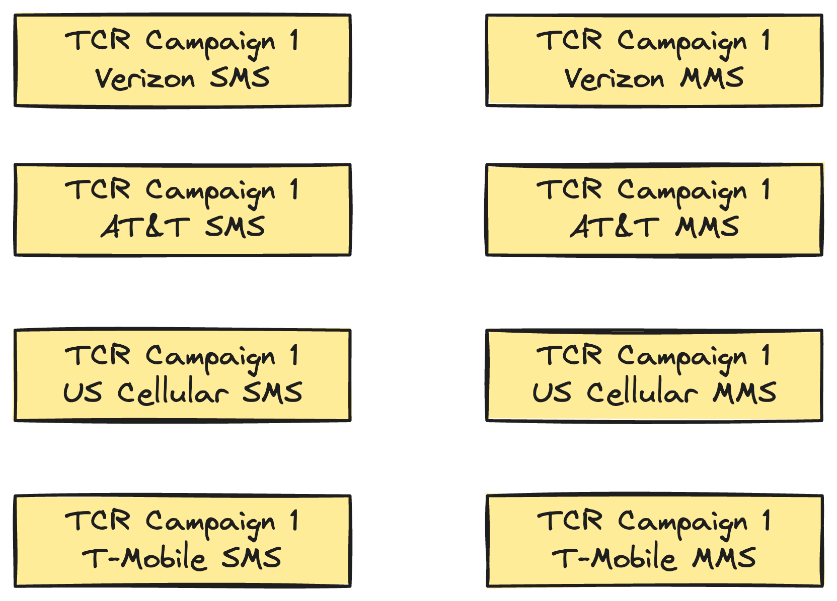
Notes:
This is potentially a lot of queues and consumers. For each TCR campaign, there are four carriers. Each carrier has separate SMS and MMS rate limits, they each get separate queues too. That brings us to 8 queues per TCR campaign.

Slide 58
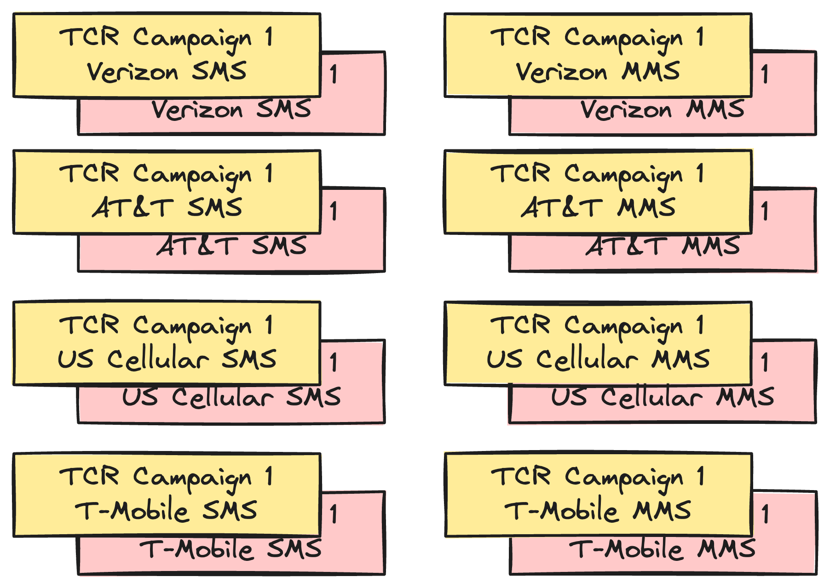
Notes:
But then that gets doubled because they all get their own dead letter queue as well. And then there are potentially even more because retry queues can be created dynamically.

Slide 59

Lesson Learned
Profile Resource Usage
Notes:
This brought up the question of resource usage. How much memory were are these queues and consumers going to use? We were reasonably confident that we were fine, but decided to do a bit of benchmarking just to be sure.
The good news is that we were right, but it’s still important that we checked. An empty Rabbit queue uses ~20KB of memory, so we weren’t paying a large penalty for having these empty queues sitting around. The same is true for Broadway consumers. Processes are cheap on the BEAM. Even though a Broadway consumer sets up supervision tree with multiple processes running underneath it, those processes don’t use much memory.
But don’t assume. Validate your assumptions.

Slide 60
Notes:
That is entire pipeline, from beginning to end. That’s not all we had to build though. The pipeline is the core of the Super Collider, but not all of it. There are other restrictions beyond rate limits that we need to worry about.

Slide 61
Campaign Sending Windows
Notes:
The main one is sending windows. Hopefully you’re not getting campaign text messages outside of legally allowed hours. If you are, then they aren’t coming from us. Regulation prohibits phone or text solicitation outside the hours of 8am – 9pm.
On top of that, our system has an additional restriction on when the initial message for a campaign can be sent. For example, a campaign may have a timely fundraising message for a university's giving day. The initial message will refer to the giving day being today. Any initial messages that are not sent out by the end of the day should not be sent.
The way we enforce this is by dynamically creating parts of our topology when a campaign opens and tearing it back down when a campaign closes for the day.

Slide 62
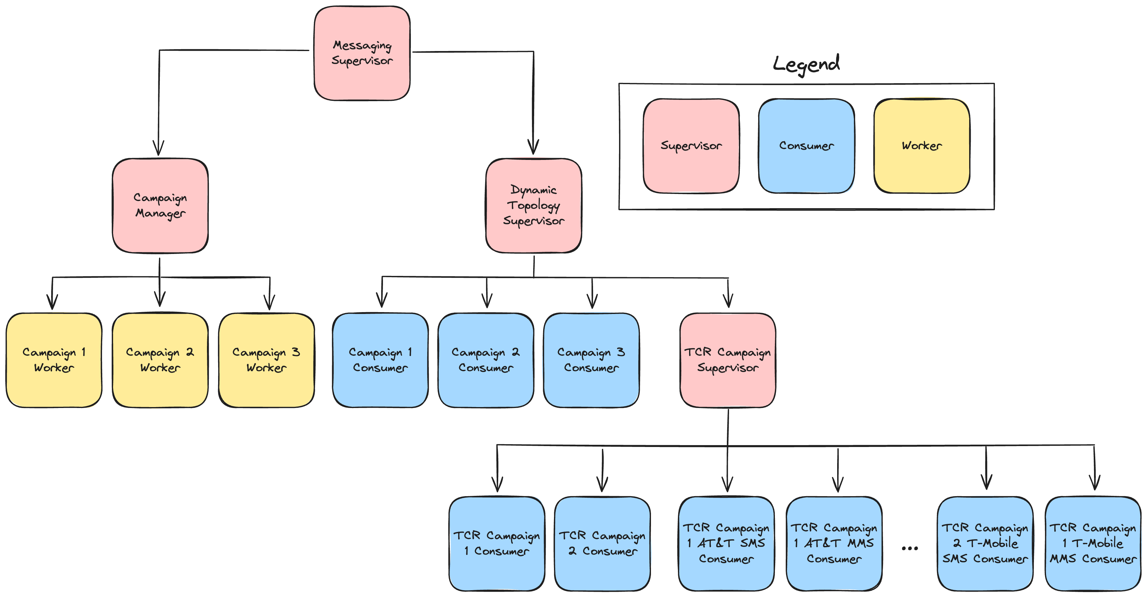
Notes:
We lean hard into what Elixir does best, small independent processes organized in a supervision tree. The bare minimum you need to understand is that Elixir applications can be thought of as a tree of processes. All non-leaf nodes are supervisors.
This is a simplified supervision tree for part of our application. When the application starts up, we create a campaign worker process for every active GetThru campaign in our system. Each campaign worker process is responsible for calling the dynamic topology supervisor when the campaign opens to create the GetThru campaign consumer and the TCR campaign consumer if one does not exist yet. The campaign worker process then schedules a message for itself when the campaign is scheduled to close.

Slide 63
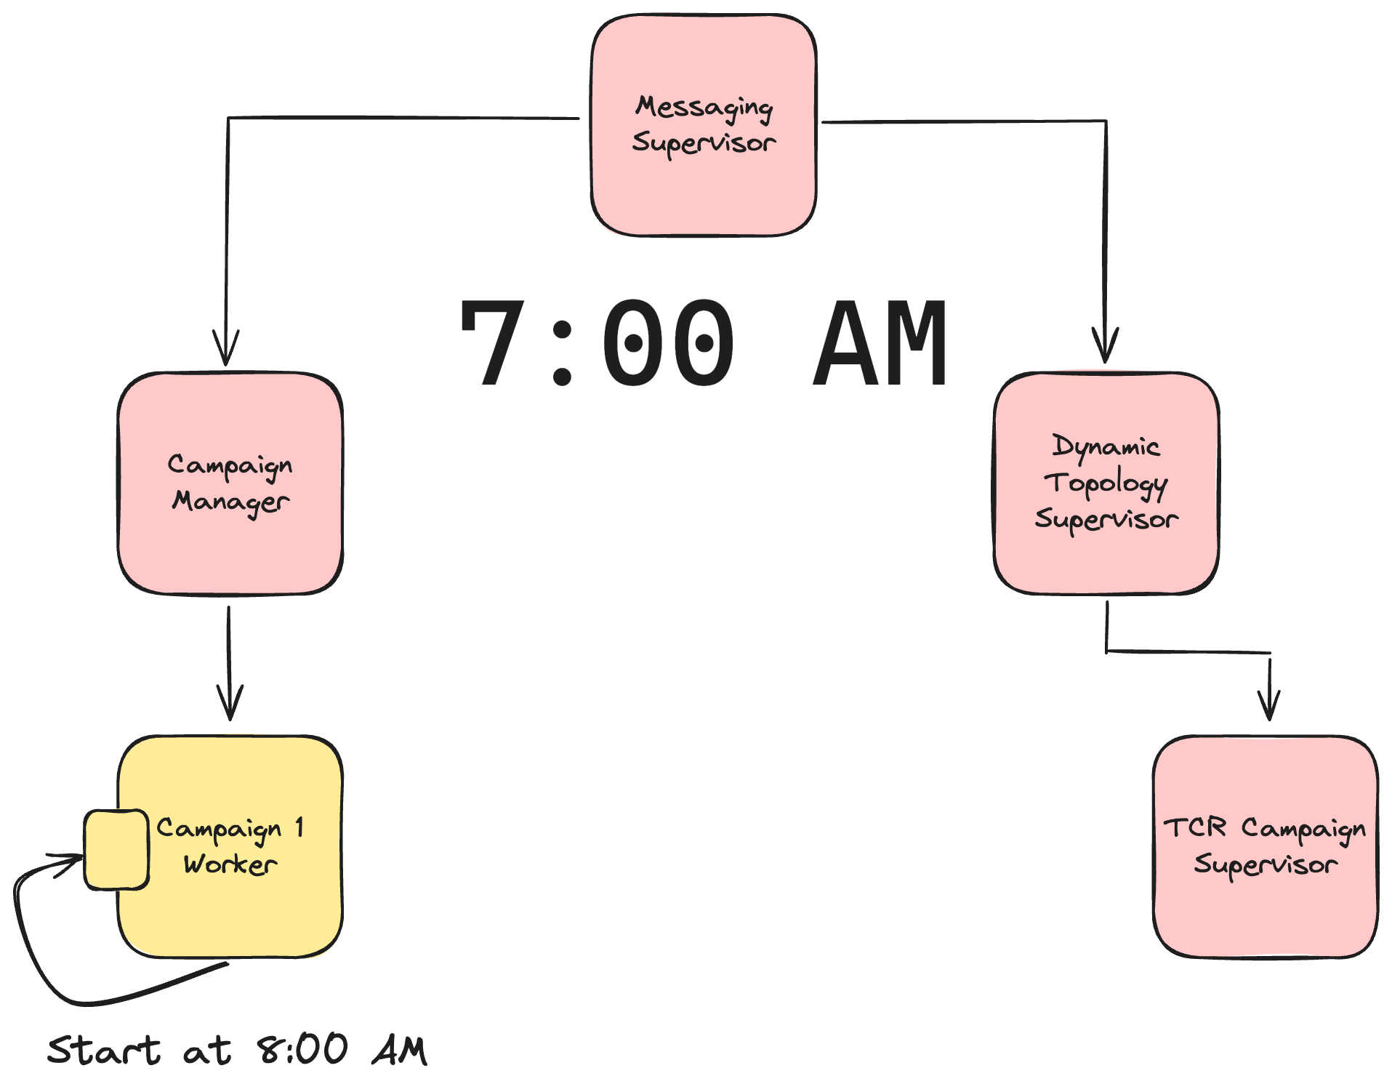
Notes:
Let’s look at a simplified example. Let’s stay we’ve started our application up at 7am and that campaign 1 is scheduled to start at 8am. No consumers have been started for this campaign yet, so no messages will be processed, even if they end up in the campaign’s queue. This is what we want. No messages should be able to go out until the campaign opens at 8 AM.
Campaign 1 schedules a message for itself at 8 AM to start the campaign.

Slide 64
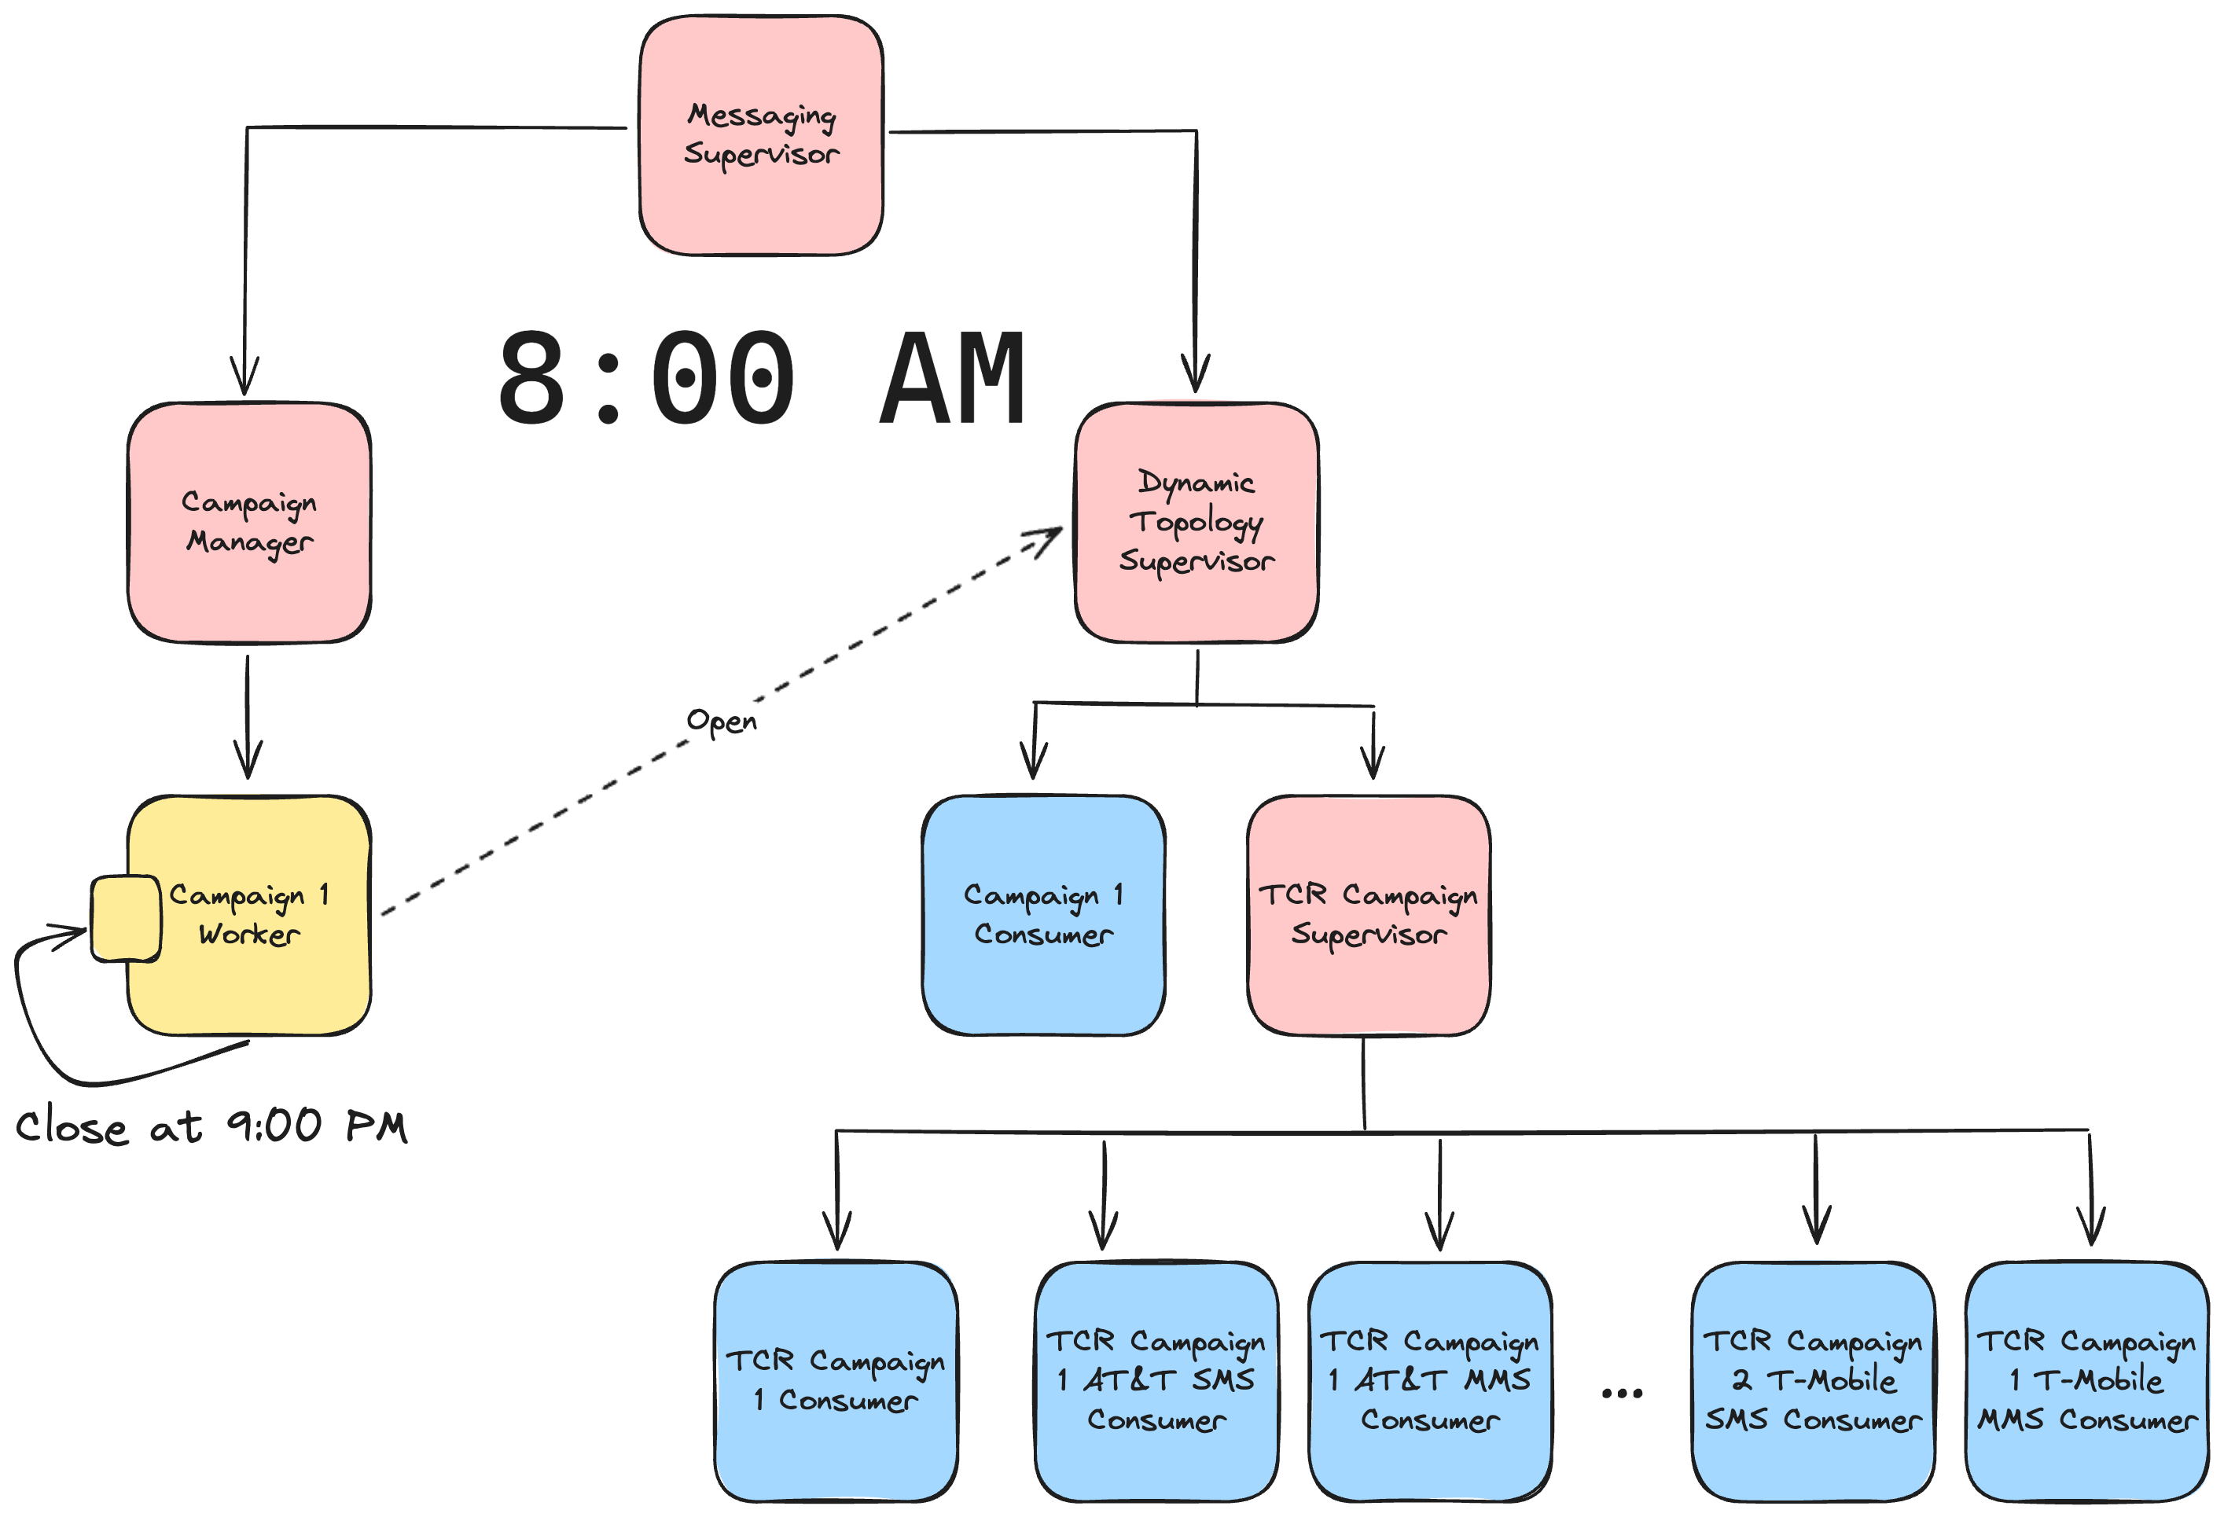
Notes:
8 AM roles around and the message gets delivered to the campaign worker process. This starts all the consumers for the campaign. The GetThru campaign consumer has beens started. The TCR campaign consumer has been started, and all the TCR campaign carrier consumers have been started as well. Once those are started, the campaign worker schedules another messages for itself. This time it’s for 9 PM when the campaign is scheduled to close.

Slide 65

Notes:
9 PM roles around. The close message is delivered to the campaign worker and it shuts down all the consumers. Then it schedules another message for itself to start everything back up at 8 AM the next day.

Slide 66

Lesson Learned
Do Not Be Too Dynamic
Notes:
An earlier iteration of the campaign worker processes tried to be even more dynamic and not start up the consumers until they were actually needed. For example, if the campaign opened at 8 AM, but no messages were sent until 8:30 AM, the consumers would be started at 8:30 when the first message was sent.
We did this by having each campaign worker process poll. We had some bugs though that caused a severe performance regression in prod on other parts of the system. We were being more dynamic when we needed to be. Moving to our current system of only scheduling messages for open and closed times made the system easier to understand and less bug prone. Elixir processes are cheap. We over engineered part of our system and paid a price for it in prod.

Slide 67

Clustering
Notes:
We've talked about a lot about rate limits, but we’ve been ignoring an important caveat. Our app runs in a cluster with multiple nodes. Each node is going to have consumers taking messages from each queue, but the queues and rate limits are global. For example, every node in our cluster is going to have a consumer to send SMS messages to provider 1. All of those consumers are pulling from the same queue in Rabbit and must respect the provider rate limit in the aggregate.

Slide 68
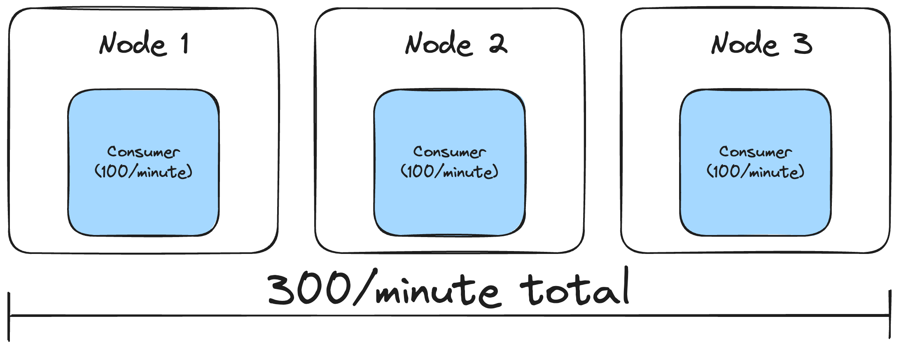
Notes:
This means that if we have a rate limit of 300 messages/minute and we have 3 nodes in our cluster, then each consumer should be rate limited to 100 messages/minute. Overall, we’ll still be respecting the provider’s rate limit of 300 message/minute and the load is spread evenly across our nodes.

Slide 69

Dynamic Rate Limit Changes
Notes:
But what happens when our cluster resizes? Luckily, the BEAM VM that Elixir runs on has us covered again. We can subscribe to events letting us know that that a node has joined or left the cluster. We have a rate limit monitor process on each node that subscribes to these events. We can update the rate limits on the Broadway consumers at runtime.
Another way this can happen is if TCR changes the score for a TCR campaign. They’ll notify us of the updated rate limits in a webhook and we can update the rate limits as needed on Broadway consumers.

Slide 70

Notes:
One of our requirements was observability. We've tackled this from a couple of different directions.
First, we're using OpenTelemetry to track a lot of information. We have a lot of traces tracking messages through the system. We also track various metrics around retries, failures, and successfully sent messages. This gives us a high level view of how the system is behaving.

Slide 71

Campaign Dashboard
Notes:
Beyond that, we've been building an internal campaign dashboard for staff members to track the health of campaigns. If issues come up, we can see that a campaign is unhealthy and pause it while we triage the issue. This will tear down all the consumers, just like if the campaign had passed its sending window for the day.
This dashboard also lets us see all the rate limits being applies to a campaign at a glance.
We also segment our customers by release groups. This dashboard lets us easily turn the Super Collider on or off for various groups of customers. This was needed because our feature flag library doesn't have support for side effects when a feature flag is toggled.
This dashboard has a lot potential, but is pretty immature right now. We haven't hit the pain points that we'll inevitably hit. Once we hit those, we'll have a better idea of what data to surface here and what control points we need to manipulate the system at runtime.
Even at this point though, it’s considerably better than what we could do in our legacy system, where we had no ability to shut off parts of the system when it was misbehaving. Debugging issues in production was a fraught experience.

Slide 72
Requirements
Respect all TCR rate limits
Respect all provider rate limits
Separation of concerns (rate limiting and business logic)
Intelligent retries
Lessen load on DB
Observability
Batch sending
Scheduled sending
Notes:
I’m going to check off observability here, but we know that we have a ways to go here. The bones are solid, but we need more experience with the system to know what gaps to fill.
We did small testing throughout the buildup to release, but as we were getting closer, it was decided that a more thorough QA plan was needed. It was time to put the Super Collider through it’s paces.

Slide 73

QA
Notes:
It did not go well.

Slide 74

Supercollider Repairs
Notes:
What happened? What did we miss? Beyond the normal bugs when implementing a new system, there were a couple of large issues that needed addressed.

Slide 75

UI Issues
Notes:
The first was UI related. We were seeing a number of oddities in the behavior of our UI while developing our pipeline. We kept putting them off though. We thought that they certainly couldn't be a big deal. I mean, the pipeline was completely decoupled from the UI, right? There was no way these UI issues were caused by our new messaging pipeline. Certainly not...
We were wrong. Very wrong.The existing message sending UI didn't handle the new pipeline well. It made a lot of implicit assumptions about latency of data being inserted into the DB that the Super Collider broke.
In addition, the messenger live views are by far the most complicated UI in our app and had accumulated the most tech debt. It reached the point that updating the existing messenger live views wasn't worth it. Our legacy system needed to continue to work while we rolled out the Super Collider. The pain of continuing to support two separate message sending strategies with one UI just wasn't worth it.
We declared tech debt bankruptcy and forked our messenger to a new version that only worked with the Super Collider. What we had thought would just be some quick bug fixes, and then thought would be just some changes that broke backwards compatibility with the old messaging system, ended up turning into a full rewrite of the core logic of these UIs

Slide 76

Lesson Learned
Unexpected Coupling
Notes:
In the long term, this is a good thing. We were able to drastically reduce the DB load that these views had. We used to hit the DB constantly to load new data. Now we optimistically update the UI when sending a message. When a message finally is sent through the Supercollider, we communicate back to the UI through PubSub to confirm that the message was actually sent. We do all of this with very little traffic to our DB. We ended up in a better place, but it was pain that we did not plan for.
In the short term, it was disastrous. It significantly delayed our launch. Don’t assume that parts of your system are decoupled. Pay attention to those bugs that are creeping in that you can’t explain. They may be pointing to a deeper issue

Slide 77

Segment Rate Limits
Notes:
We ran into one other large issue.
This entire talk I've been talking about rate limiting by message, but that has been a little white lie. SMS messages are comprised of segments. When a message gets to a certain length, the message is split into multiple segments. Well… it turns out that our SMS rate limits for carriers and providers are by segment, not message.
In our defense, a lot of the documentation from TCR and our providers is unclear about this. But it doesn't matter how we got here. Either way our rate limiting was wrong.
We thought about hacking around this by looking at the average segments on a message. That would stem the bleeding until we could get a real fix. Unfortunately, the number of segments varies a lot. We were going to exceed our rate limits too often to be comfortable.
What we really wanted was a weight on a message so we can say how much it counts toward the rate limit. If a message is 3 segments, we want it to count as 3 towards the rate limit. Then we can continue to rate limit through back pressure.
Unfortunately, this is not supported out of the box with Broadway. Fortunately, Broadway is open source, so we were able to fork it internally to add weight to messages. For now, we’re maintaining this fork ourselves, but we’re hoping to get it upstreamed back into Broadway. The main issue there is going to be philosophical. Does the Broadway team think message weights should be a feature or not? There are some weird corner cases that rate limiting by message weight introduces. We haven’t had those conversations with the Broadway team yet.

Slide 78

Lesson Learned
Understand Your Domain
Notes:
That brings us to one of the roughest lessons we learned: understand your domain. We did not ask enough questions to understand earlier that so many of our rate limits were actually by segment and not message. This was wrong in our current/old system and we didn't question it.
I think we would have ended up in a similar place of adding weights to messages in Broadway, but this is the kind of high risk work that should have been identified sooner so we could front load the risk to the beginning of the project, not the end. This was a significant technical risk for us and we flat out missed it.
So, be sure to poke and prod at your domain from different angles. Be ridiculous and play devil's advocate. Consider doing pre-mortems on a project. Ask what would happen if X failed or Y was true. You may come up with scenarios you don't care about, but at least you're consciously setting them aside instead of being surprised later.

Slide 79

We Haven’t Shipped
Notes:
Now we come to the moment of truth. We’ve fixed these issues. We rewrote the live views for our messenger UI. We forked Broadway so we can correctly rate limit by segment instead of message.
I submitted this talk to StirTrek in late January. At the time we were early in testing to start rolling out to production. This was right before the depth of our UI issues came to light.
Has anybody ever thought a project was almost ready to launch and then learned there a bunch more work to do? That the first 80% was done and now only the second 80% remained. That was us and that is why we haven’t shipped.
But we’re shipping very soon. Hopefully for real this time! And that is why I can’t stand before you today with lots of pretty charts showing our performance in production between the two systems. For that I apologize. I’m sure just about everybody in this room has been in a similar position, just maybe not standing in front of an audience having to admit it publicly.

Slide 80
What We Liked
ADR process
Improved unit testing
Documentation with ex_doc
Rate limiting in Broadway
RabbitMQ
Improved UI performance
Elixir
Notes:
Writing an ADR was a great early step. It was a touch point for the team to agree on what was being built and the high level architecture. I joined the team after the project was started and being able to refer to the ADR was helpful in getting up to speed. It wasn't a panacea though. For example, we missed on the segment rate limiting. Ideally, we would have caught that in the ADR process. There are lots of philosophies out there on how detailed ADRs need to be. I recommend starting on the lighter end and adding more detail as needed.
Our new pipeline is much easier to unit test than the old system. Stages are completely isolated from each other and we’ve structured our modules to make the core business logic testable without any dependency on Broadway.
ex_doc is the documentation system in Elixir and it has been fantastic for us on this project. It generates very nice documentation from Markdown that lives right next to your code. We were able to generate documentation at multiple levels of understanding. Embedding Mermaid diagrams right in our docs was great too. I constantly referenced our documentation while putting together this talk.
The way we were able to easily rate limit messages in Broadway with back pressure was great. This was way better than our previous system of constantly retrying messages. It wasn’t ideal that we had to fork Broadway to add weights to messages, but even that was easier than we expected.
We’ve been very happy with Rabbit so far. Because we're an Elixir shop and RabbitMQ is written in Erlang, debugging issues with it is not anywhere near as intimidating as it might be for other shops. The lesson learned here is to use tools that you're already comfortable with. Don't introduce new infrastructure that you don't need.
Because we were doing less work up front and bulk inserting as the first stage in the pipeline, the UI became more responsive. A downside of this is that doing less work up front broke a lot of expectations that UI was making. We ended up having to rewrite the core logic of those screens, which were the most complex part of our app. That led to even more UI performance improvements though.
And finally, we continue to love Elixir. We have a small team of 6. Over the past 6 or 7 months of building this, only 1-2 engineers were working on it at any one time. That’s not a lot of engineering effort for such a complicated system. More than we anticipated, but much less than in other orgs.

Slide 81
Future Improvements
Batch and scheduled sending
Daily caps and retry strategies
Separate queues and consumers for 3rd party integrations
Clean up tech debt
Improved automated tests
Load testing
Improved caching
Improved observability
Linked traces
Event sourcing with RabbitMQ streams
Notes:
Future improvements, beyond, you know, actually shipping.
We haven’t implemented batch and scheduled sends yet, but with our current architecture it should be straightforward to implement.
We use the same retry strategy for all rate limits, but we would benefit from a different strategy for daily caps. There is no point in continuing to retry a message until the next day if the daily cap has been hit.
We currently use one queue and consumer for all 3rd party side effect integrations. It would be nice to split these out at some point.
We currently have two systems for sending messages. We're looking forward to fully removing the old system once we're fully over to the Super Collider. That will simplify large parts of our system.
While our unit testing is much better, we struggled to write comprehensive automated tests for parts of the system due to the dependency on RabbitMQ. We would benefit a lot from starting to look at system level tests of various scenarios of messages going through the entire pipeline.
End-to-end load testing is currently very expensive because we send out actual text messages. We have the beginnings of our own internal mock provider. Building this out more is really necessary if we want to do repeatable load testing without breaking the bank.
The bulk inserts and updates helped a lot with DB performance, but there are places scattered throughout the pipeline where we still read from the DB. We want to convert most/all of these to use caches instead.
We have a basic start on observability, but we need to bang on it more in production. The goal is to have it hardened and very observable by the November election.
We're using OpenTelemetry, but the service we send our traces to only recently added support for linked traces. This would allow us to link together all the traces for a message as it flows through our pipeline. We can trace this through logs to a certain extent now, but being able to do so through linked traces would be nicer.
And finally, this last one is pretty speculative. If we used RabbitMQ streams, we could have a stream per campaign in addition to the queue, Then we could expose that stream on our internal campaign dashboard. If we publish a message to the stream whenever a message gets moved through our pipeline, we end up with an audit trail of how a message moved through the system. The dashboard could show the full history, a slice of time, or just tail what is currently happening.

Slide 82

Website
https://brianmeeker.me
Mastodon
@brianmeeker@hachyderm.io
Any questions?
https://github.com/CuriousCurmudgeon/messaging_with_limits_talk
Notes:
Overall, we're pretty happy with what we've built. We recognize there is a lot of polish to be done over time, but we're confident that we have a system that can stand up under the load of an election season.
I wish I was standing here with a system in production and hard data to show you, but, unfortunately, things didn't work out that way.
Many thanks to everybody I work with at GetThru. I'm the one up here talking, but everybody on our team worked on this project in various ways. If you have any questions, come on up and chat or find me later. You can also track down my co-worker, Matt. He is probably more responsible for this system than anybody else at GetThru.
The slides will be available on GitHub and you can find me on Mastodon or in the Stir Trek Discord if you have questions after the conference as well. Thank you and enjoy the rest of your day.

Slide 83
Broadway & Rabbit In Anger
Notes:
That was a quick overview of our domain and initial plan. If you want a more thorough breakdown of our domain, I encourage you to check out a previous version of this talk that I gave at Stir Trek back in May. It’s available on YouTube.
The real learning starts though when you start using a system in anger.

Slide 84


Slide 85
Use Release Groups
Notes:
First, let’s look at a wise choice we made before rolling out the Super Collider to anybody. That was release groups. Rolling out a large, complicated system to all customers at once is not a good idea. In our case, we assign every account to a release group. For each release group, we click a single button to toggle it on and off. This toggles the feature flag for that release group in fun_with_flags and then creates all the queues in Rabbit needed by all the active campaigns that account has.
One tweak we quickly learned after trying to turn it on for the first release group was that it needed to be throttled. Without a throttle, we were trying to create thousands of queues all at once in Rabbit.

Slide 86

Notes:
Don’t be the thundering herd.
Back in May we turned on the system for just a few customers just to kick the tires on it in prod. This wasn’t even a full release group. It was just a subset of one of the planned release groups. And that went well. We found a few bugs and quickly fixed them. Our customers were finally sending messages through the Super Collider! It was great.
Then it was time to turn it on for the first full release group. I was on vacation, relaxing in the mountains of Tennessee, completely disconnected from work. Little did I know that my co-workers were dealing with our first incident.

Slide 87
Act I: The Pooling
Notes:
One of the advantages of working in a domain where you can only send text messages at certain hours is that we have late night windows where the system is essentially unused. We have a window from when texting ends on the west coast and before it starts in the UK. We decided to take advantage of this to turn on the first release group in the middle of the night.
Rabbit immediately became unresponsive. Our error monitoring spammed Slack with so many messages that Slack became unusable. Rolling back the release group and getting the system stable again took a few hours. What happened?
The issue turned out to be something we had noticed, but not taken seriously. We knew something was off, but didn’t take the time to investigate it before the rollout.

Slide 88
Use a Custom Broadway Connection Pool
Notes:
And that is the default behavior of the Broadway RabbitMQ producer. While the default way connections and channels are managed by the producer for apps with a limited number of consumers is fine, it is not fine for an app with thousands of consumers. This is because the default strategy creates a new connection for each producer with a single channel. This gives you a 1-to-1 ratio of connections to channels. That is very much against the RabbitMQ recommendation to create few connections with many channels.
Given all the consumers we attempted to create for each GetThru campaign and the corresponding carrier consumers, we attempted to create almost 12K connections to our poor Rabbit cluster.
There are some existing libraries out there, but we decided to roll our own fix. On application startup, we create a connection to Rabbit for each BEAM scheduler. By default, there are two schedulers per core. We have 16 core machines in our k8s cluster, so each node opens 32 connections to Rabbit. When checking out a channel, each producer gets the connection for its scheduler and then opens a channel. When checking the channel in, it just closes it.
On the plus side, the Broadway RabbitMQ producer is incredibly resilient. In trying to find the root cause for another incident, we tried to get it to leak channels in various ways by killing processes and supervisors. No matter how we tried, we couldn’t get it to leak channels. It consistently our custom pool to check channels in no matter how we tried to break it.

Slide 89
Hosting Matters
Notes:
Even before this incident, we had not been happy with AWS’s RabbitMQ offering, Amazon MQ. It didn’t give us the kind of observability we needed. It severely limits how you can get metrics out in a way that doesn’t bloat your AWS bill. This is not an advertisement, but we ended up switching to CloudAMQP. Now we get all the metrics we want into Datadog. In addition, it’s been easier to get ahold of somebody when something goes wrong. Such as opening so many connections that your server becomes completely unresponsive.

Slide 90
Unrouted Message Handling
Notes:
After recovering from the incident and implementing a reasonable channel pooling strategy, we were able to successfully turn on the Super Collider for our first release group. While we didn’t run into any large incidents again with this release group, we did have a number of smaller issues to address.
First, we would occasionally get unrouted messages. The campaign and carrier queues in our system are dynamic. If something went wrong when creating that queue and we didn’t catch it, sending messages to that queue didn’t fail in the way we expected.
We had expected that setting the `mandatory` flag when publishing a message would cause an error to be returned if the queue did not exist. What actually happens is that Rabbit sends a `basic.return` command back on the channel.
AMQP lets you register a handler for this. The problem is that our code expected this to return an error. Publishing with the mandatory flag to a non-existent queue returns `:ok` and then the return handler gets called if you've registered one.
Instead of implementing this handler and dealing with what is now an asynchronous publish operation, we went with a solution in Rabbit itself. Rabbit allows you to create what is known as an "alternate exchange". If you send a message to an exchange and no bindings exist to handle that message, then it will get sent to the alternate exchange instead.
Our alternate exchange is dumb. It is a fanout exchange with one binding to a `text.unrouted` queue. We have a consumer that watches this queue for messages. It consumes the messages, emits a metric letting us know there was an unrouted message and then marks it as failed so it gets sent to a DLQ.
Now, in the rare event that we get an unrouted message, a monitor in Datadog pages us and we can intervene as needed. This usually means creating the missing queue, shoveling the messages to the new queue, and then debugging why the queue didn't exist in the first place.

Slide 91
Limit Telemetry
Too much of a good thing
Notes:
OpenTelemetry is great. We send a ton of telemetry to Datadog. But it isn't free and you need to be careful about it. It's a terrible feeling to see your system melting down and your dashboards stop working because you're sending so much telemetry that your Datadog agent can't keep up.
One thing on our todo list is to split our telemetry into two different agents that run inside of k8s. One agent will be for metrics and one will be for everything else.
Why would we want this split? The basic issue is that we rely on metrics to give us an understanding of the state of our system. And when the system starts melting down, we want to keep getting those metrics in Datadog. During an incident your system may be spewing out so many error logs that your ingestion agent just can’t keep up. During one incident we logged ~1M messages in a 15 minute window. This overwhelmed our poor Datadog agents and risked our metrics becoming inaccurate or stale.
But even in a non-pathological case we knew our telemetry was unsustainable and had been turning it down. During development and the initial rollout, we kept logging and traces high, but we had started turning that down as traffic ramped up.
Originally, we were logging the entire pipeline message at every stage in the pipeline. Twice. Then some stages had additional logging as well. Additionally, we were sending multiple traces in every stage and some stages were sending some metrics as well. This was primarily around actually sending a text message through a provider, retrying, or giving up.
Each US message going through our pipeline went through the following stages.
- bulk ingest (very little logging for a batch)
- campaign
- carrier
- bulk update
- side effects
The campaign, carrier, and side effects stages all logged a lot. That meant that every text message we sent was logging at least six separate times (and probably more). It was sending upwards of 20 traces. And it was logging a few metrics.
This is all compounded by our traffic being very bursty. A very common usage pattern for us is low traffic with spikes as a customer launches a large campaign and sends all of their initial messages. That means we can get lag in our DD agents when they get a burst of traffic. Between bursts and error states, you need to keep your worst case scenario in mind for telemetry. How is your telemetry going to perform under pressure?

Slide 92
Rate Limit Getting Your Rate Limits
Notes:
We get rate limits for some carriers from TCR. For some carriers, this varies depending on a number of factors. This means that we need to get those rate limits from TCR.
The issue is that the TCR API has its own rate limit. We enforce this through Hammer. The legacy system would check a cache when sending a message. If the rate limits for that TCR campaign were not cached yet, we would make an API call to TCR to get the rate limits for the TCR campaign. They would get added to the cache with a TTL of 15 minutes. Why this was so short remains a mystery to this day. These rate limits almost never change.
Anyways, we didn't realize how this cache worked when we deployed the SC. We knew there was a cache for TCR rate limits and we started using it. The problem was that our usage of this cache was wildly different than the legacy system. On node startup, we startup many TCR consumers. Every single consumer checked the cache for this rate limit. On startup, nothing was cached yet. When campaigns opened, the hit rate was low because of the low TTL. And on a cache miss, we made an API call to TCR. Our TCR API rate limit is 20 calls/second. This was a problem. We were way over that.
And the cache had made another choice that didn't work well for our new use case. When something went wrong, instead of failing it would return a fallback rate limit for each carrier. And it would do that silently. It wasn't clear that we were falling back to a default. In practice, this meant that one node in our cluster might get the correct rate limit from TCR, but all the other nodes would get rate limited and use the fallback.
Fixing this was an unexpected side quest. We now store TCR rate limits in our DB. TCR notifies us with events that let us know the rate limit may have changed. Just in case we miss one of these changes, there is a button we can click to request updated rate limits for a TCR campaign. And there is also a mix task we can run to refresh all rate limits. All of these requests are rate limited using a global rate limit on an Oban queue. Problem solved.
It was wild and unexpected though that we got burned by a rate limit getting our rate limits.

Slide 93
DLQs and Immediately ACKing
Notes:
While trying to fight another issue with duplicate text messages being sent, we started immediately ACKing messages in each Broadway consumer. This had an unfortunate side effect that caused us to rollback the change.
It turns out that you can’t fail the message after it’s been ACK’d. When you say it out loud, that makes sense. You’ve told Rabbit that you’re handling the message and that it doesn’t have to care about it anymore. We only realized the problem when we realized that messages in retry queues were not going to the DLQ after failing too many times. The messages just disappeared even though we had marked them as failed.
Luckily, we got this pretty quickly and we found different ways to deal with duplicate message sending.

Slide 94
Static Retry Queues
Notes:
We talked about them earlier, but retry queues have been a recurring problem for us. The solution of retry queues where every message has the same TTL worked great for exponential backoff, but we actually ended up tweaking this for a couple of reasons.
First, to avoid an explosion of retry queues in the worst case, we moved towards static retry queues. The problem with dynamic retry queues is that the number of queues in our system could explode in a worst-case scenario. If an incident causes messages to start retrying across many campaigns, all of a sudden we're creating many more queues. This risks cascading failures. If we an incident creates so many retry queues that Rabbit performance degrades, then we're in for a world of pain.
So, we moved to just one static set of retry queues for each strategy, exponential backoff and the T-Mobile daily retries.
For exponential backoff, we have a set of 10 static retry queues, one for each attempt in the backoff. All messages in the first retry queue have the same TTL. So do the second and so on. When the TTL expires, the message gets routed back to its origin queue according to it's routing key.
This gives us a static amount of resource usage and eliminates any issues with dynamic queue creation for retries. Be only as dynamic as you need to be.
T-Mobile retries are special because of the daily cap. Every message that hits the cap gets sent to this retry queue with a TTL of midnight PT. All of the messages will hit their TTL at midnight PT and get routed back to their origin queue to try again the next day. Once again, no dynamic queue creation needed.
This also fixed a bug where queue TTL didn't work as we expected. We had misread the docs and thought that a queue TTL would reset when a message was published to it. This is wrong. Queue TTLs only reset when a consumer connects. And since our retry queues never have a consumer connect to them, that meant their TTL never reset. Depending on the timing of when messages were added to the queue, this meant we were losing some messages in retry queues when the queue TTL was hit.

Slide 95
Act II: The Channeling
Notes:
After addressing the main connection and channel issues in the first incident, we had continued to roll out the Super Collider to more release groups. The next-to-last release group added a decent amount of load to Rabbit, but we thought we were fine. We were wrong.
We knew from our monitoring that our memory usage on Rabbit was a bit high, but it was tolerable. Unfortunately, what we did not have good monitoring on was our CPU usage. One morning after an unrelated deployment, we noticed that messages had stopped sending about 10 minutes ago. Then we got paged.
The system was crumbling before our very eyes. We had gone from our steady state of ~60K channels in Rabbit all the way up to 400K. Our CPU usage on every Rabbit node in the cluster was pegged at 100%. Memory was using a large amount of swap. We were unable to get the system under control and started disabling the Super Collider for each release group to try and get resource usage under control. This rolled customers back to our legacy system so they could continue to send messages while we surveyed the wreckage.
To our best knowledge, what happened is that we do blue/green deployments. We spin up a few new nodes, wait for them to be healthy, and then shut down the old nodes. This means that on each deployment our system has more nodes than usual for a brief period of time. We had not taken this into account when evaluating our Rabbit resource usage. We were flying too close to the sun and deployments pushed us over the edge.
When Rabbit got pegged at 100% CPU usage we think that channels became unresponsive. In response, the Broadway Rabbit producer thought it had a bad channel and opened a new one. This led to a catastrophic rise in channels from 60K -> 400K.
We ended up having to ask CloudAMQP support to restart our Rabbit cluster. It was completely unresponsive to any requests we could make.
This incident was embarrassing to say the least. We had some customers not have their text messages get sent out. We hadn’t understood the behavior of our system well enough to head off what should have been an obvious risk. We had been watching memory usage all week and thought we were fine. We were not. In addition to code changes, we increased the size of each node in our Rabbit cluster to give ourselves more head room going forward.
The good news is that all traffic was now back on the legacy system, so we had an opportunity to do some invasive fixes that would have been more difficult if we had to worry about in-flight messages.

Slide 96
DLQs and Memory Usage
Notes:
One way to deal with our memory usage was to look at the sheer number of DLQs that we had in our system. Every single campaign queue had it's own DLQ. Every single carrier queue also had it's own DLQ. Before we deployed, we thought this was going to be fine. We had benchmarked how much memory a queue uses at rest.
Unfortunately, we hadn't accounted for the overhead of running in a cluster and the overhead of switching to quorum queues. We benchmarked on classic queues, but switched to quorum queues at some point. We didn't benchmark again. The end result was that we flew too close to the sun in production and had a serious outage. We had to rollback all message sending to our legacy system.
Looking into the wreckage of this, we saw that our queues were using more resources than expected; at least twice as much. And we hadn't accounted for the CPU usage of these queues at all. We should have realized that would be a thing. Each queue seems to spin up a couple of Erlang processes. Even without processing Rabbit messages, they still apparently do process some BEAM messages.
Now that the system was shutoff, we took the opportunity to consolidate our DLQs. All campaigns now use the same DLQ. All TCR campaign carrier queues also use the same DLQ. We went from 10's of thousands of DLQs down to 2 for these stages.
The downside here is that we can't blindly shovel messages back and forth. Each DLQ now has messages from many different queues. This was pretty easily solved with our own shovel tool though. Every message still has the original routing key. We just pull each message off the queue and publish it back with the original routing key.
And honestly, the interface we put together is way nicer than the generic interface in the RabbitMQ Management Plugin. The sheer number of queues we have makes that dashboard pretty sluggish. Once you get over ~10K queues, you really need to prioritize your own tooling.
Don't be afraid to deviate from best practices when appropriate. We had too many queues, so we consolidated the dynamic parts of our system to one DLQ per stage. This saved a lot of memory and CPU on the Rabbit end

Slide 97
Rabbit Queue Names
Notes:
While the system was down, we also took the opportunity to change our queue naming strategy.
In short, follow the RabbitMQ guidelines when naming your queues. Separate words in your queue names with dots.
The big thing to understand is that Rabbit uses `.` as the delimiter between words in a queue name. And you can use `#` and `*` as wildcards in routing keys.
We made the mistake of using underscores as delimiters between some parts of the queue name and dots for others. It wasn't causing any current issues for us, but would have cut off future options. Fixing it while the system was not being used was easier.

Slide 98
Campaign Worker Memory Usage
Notes:
In Elixir, we often brag to other communities about how little memory our processes use. How many of them we can deploy at once without issue.
However, this gets thrown out the window if you do stupid things at scale. Yeah, the BEAM process itself is cheap. A GenServer a bit less cheap, but still cheap in comparison to other ecosystems. When you have thousands of processes and don't pay attention to what state you're throwing into that process, you end up in a sub-optimal place.
Luckily, this one didn't burn us. There was no production incident out of this one. But there probably would have been one at some point. Many thanks to Matt for getting ahead of this one.
The main issue was that we were passing an Ecto schema struct into each process. That's reasonable. The mistake was then storing that struct, with all of its preloads in the process state. We should have only been storing the pieces of information that were relevant for the process.
Making this change saved us over 1GB of memory on each node. That lets us continue to use smaller VMs in our k8s cluster. There are probably other memory savings we could get on each campaign worker, but it was good to harvest the low hanging fruit early.

Slide 99
Act III: The Processing
Notes:
And that brings us to our final big incident before we turned on the final release group. Once again, this came from a change that we thought was pretty safe.
Verizon wants us to rate limit messages per phone number, not per TCR campaign. This change was going to create over 10K more queues in our system, along with consumers for each of them. This was a lot, but we had bought ourselves a lot of memory overhead by both increasing the size of each node in our cluster and by consolidating our DLQs. We had plenty of CPU and memory this time to add that many queues.
In addition, we had called it out as a risk before deployment. Instead, we got hit by an unexpected problem. One that I had actually been wondering about sometime in previous weeks leading up to this.

Slide 100
Insert can’t spawn process error here
Notes:
Has anybody ever seen this error message in prod? I had been idly wondering what the failure mode was when the BEAM hits the process limit. Now our entire team knows.

Slide 101
BEAM Process Limits
Notes:
Before this project, our system didn't create many processes. Of course we had processes for Phoenix requests, Live View, Ecto, and the other usual suspects, but we hadn't done any heavy, heavy usage of processes ourselves. We noticed that the process usage was creeping up as we turned on release groups, but didn't think much of it. We still had a lot of head room.
This was another issue where we didn’t have good monitoring or alarms. When turning on release groups at night, we were checking what percentage of our process limit was being used. At the time, that was only 30%. The mistake was not realizing that the number was growing during the day as campaigns opened up. During the day we were peaking at ~60%.
Rabbit wasn’t going to have any issue opening up so many new channels for each consumer, but our Elixir nodes reached the process limit. We were creating ~12K new queues and consumers. Each consumer is itself a supervision tree with multiple processes underneath it, so were spinning up tens of thousands of new processes. Luckily, this was pretty early in the morning when the system was barely being used. We were able to quickly rollback the change and clean up any messages that had ended up in DLQs.
I ran a script to delete all the new phone number queues from Rabbit while we started reading docs to update our process limit. There is a flag for this, but we need to do some experimentation to find out what number will work will with the size of our nodes in k8s.
We haven’t actually upped this limit yet. Verizon phone number rate limiting is something we want to come back to, but it hasn’t been high enough priority to come back to yet.

Slide 102
All Release Groups Live
Notes:
Shortly after that incident, we were able to turn on the final release group and have all traffic now flowing through the Super Collider. Since then we’ve fixed several other issues though.

Slide 103
Custom Tooling For Fun & Profit
Notes:
Incident responses have often been painful because we didn’t have good tooling to recover messages once the system was running again. After the process limit incident, we created several new tickets to address this.
First, we now have tooling to easily shovel messages from DLQs back to their origin. This took something that previously required navigating through either the RabbitMQ management dashboard or working directly in prod through IEx, and turned it into a couple of clicks on a DLQ dashboard in our staff tooling. That dashboard also gives us visibility into what DLQs even have messages in them right now. That’s been a huge time saver. It’s also much less risky than working in IEx in prod. It’s fantastic that we can do that in Elixir, but you shouldn’t need to do it for common tasks.
Another one is a button to restart TCR campaign supervisors. We don’t know why yet, but sometimes they get stuck with unacked messages. Having a single button that support or development can click to kick the tires on those is great.
We’re also experimenting with cron jobs that proactively look for degraded campaigns. This exposed that we need to some more thought into what it means for a campaign to be in a degraded state, but I’m hopeful that self-healing jobs like this can be a regular part of our system going forward. Ideally, you wouldn’t have any issues and nothing would need self-healing, but that’s not reality.

Slide 104
Build Nice Monitoring Dashboards
Notes:
Another win has been taking the time to improve our dashboards in Datadog. Telemetry is only one part of observability. You need to take the time to use that telemetry to build nice dashboards and monitors.
You need to be thinking about what you're going to use that telemetry for? What is useful for real-time debugging? What is useful as historical data? What is useful for monitors so you know when the system is degraded or at-risk of becoming degraded?
And this includes your infrastructure. If we had better monitoring beforehand, we could have avoided so much pain around Rabbit resource usage and BEAM process limits. I’m sure there are other things we’re not monitoring now that we should be, but learn from each incident to improve your monitoring.
Take the time to learn your monitoring tools. These tools are incredibly powerful. They have an overwhelming number of features. It is worth the time and effort to learn how to use them.
And we're far from perfect on this. I'm still learning new things about DD every week. But your team needs to understand what they can do and how they ingest data. This will prevent you from overwhelming your agents and give you the observability of your system that you need.

Slide 105
Consumer Creation Order
Notes:
One other minor change we made was to consumer creation order. We started seeing occasional errors with unrouted messages when campaigns would open up on the hour. The issue turned out to be that a campaign would have messages waiting to go out sitting in the campaign queue. The campaign consumer was started first and started processing messages while the carrier consumers were being started up. Sometimes the campaign consumer would start publishing messages to carrier queues that hadn’t been created yet.
The solution here was to start consumers from back-to-front in the pipeline. This ensures that the queues for later stages always exist before earlier stages start up and try sending messages to them.
And vice-versa for shutdown. We always shut down dynamic consumers from front-to-back in the pipeline.

Slide 106
Epilogue
Notes:
And that ‘s roughly where we are today. But we do have several other improvements on the docket. We expect to get to some of these before the election, but others will probably wait until after.

Slide 107
Auto Archiving Campaigns
Notes:
The first one is auto-archiving campaigns. For years, we’ve had an issue where there are no rules for auto-archiving old campaigns. It’s been an annoyance, but the way the Super Collider works has made addressing it a higher priority. We’re creating a lot of consumers and queues that don’t have any messages flowing through them.
This issue is that most of the ”active” campaigns in our system haven’t actually had messages sent through them in months. But a customer could sign in at any time and send a message through them.
We had attempted to work around this earlier, but ended up reverting that change. We had tried to not open consumers until somebody actually tried to send a message on a campaign. We could revisit that in the future, but it doesn't solve the problem of a queue already existing. And queue count has been our enemy.
The fix is to define rules for auto-archiving campaigns and run a nightly job to close them. Depending on how strict we are with those rules, we think we can reduce the number of active campaigns in our system by 40-65%. That’s a huge savings in number of queues and Broadway consumers.
These changes will hopefully allow us to reduce our resource usage in Rabbit by over 50%. That's huge. It gives us a ton of room to grow going forward and opens up the possibility of slimming down our spend on RabbitMQ post-election.

Slide 108
Do Not Share Channels Across Processes
Notes:
We talked earlier about our custom channel pool that we hook into Broadway. However, not all channels in our system are related to Broadway consumers. We also have channels to manage some parts of our topology and, most importantly, to publish messages. All the same rules about not reusing channels across processes apply here as well. Let's walk through an example.
Let's say process A get a named channel from. We can see the PID of this channel here. Process B also gets a channel with the same name. We can see that it has the same PID. This is the same channel being shared across processes.
Process A performs an action on the named channel that causes the channel to be closed. One example of this is attempting to get the status of a queue that does not exist. This will cause the underlying channel to be closed.
Process A can see that something went wrong and that the channel is closed. Process B can not. It won't know that the channel is closed until it tries to perform an operation on the channel.
AMQP does reestablish the channel, but it is a new channel with a new PID. You have to get the named channel again through the AMQP library to get the new channel.
At time of writing, we haven't fixed this yet. It's probably the highest priority bug left in our system. We're pretty sure it leads to sudden bursts of errors we sometimes see. Many processes have a reference to the same channel. One process performs an operation that causes the channel to close and then all the other processes continue trying to use it.
The solution is simple. Do not share channels across processes. Each process should have separate channels. Depending on your use case, each process could create their own channel or they could check one out of a channel pool. In our case, we should probably have a channel per processor for publishing. This will avoid a lot of churn in channels. Each processor is a long-lived process inside of Broadway that handles many messages. We can probably create a channel by name still, but that name will be unique to each process. The trick will be closing down the channel when the processor closes to avoid leaking channels.

Slide 109
Circuit Breakers
Notes:
After our channel explosion incident, we brainstormed tools that would have been useful for future incidents like that. A big one was our need for circuit breakers in the SC. We needed to be able to turn the entire thing off or individual stages.
In the case of that incident, our UI optimistically updates, so users were not aware that messages were not being sent until they refreshed their screen. This mean navigating away from the messenger and coming back or actually refreshing. The odds of a user doing this during their normal work are low.
This is because the messages are not persisted to our DB until bulk insert, the first stage of the pipeline. If we had been able to turn off all other stages of the pipeline, we might have been able to continue bulk ingesting messages while we diagnosed what was going on with other parts of the system. Messages would have been bulk ingested and then published to the correct campaign queues. They could have just hung out there while we debugged.
Another advantage of this is that our send message stage depends on a third party integration. We call a third party API to send our text messages. And third party APIs can go down. Having a way to trip the circuit breaker to shut down the send message stage would have been very valuable. For many reasons, it's not easy to transfer traffic within a campaign from one provider to another, but at least we can stop spamming they system with retry errors while we wait for them to come back up. We do exponential backoff on those retries, but if volume is heavy, that's still a lot of retries for messages that we know can't go out right now. Don't thrash when you don't have to.
In the worst case scenario, we could automatically trip the breaker. We know what percentage of our API calls to our providers are failing. If the percentage is high, we could trip the breaker and watch for the API to come back up.
This is something we would love to have before the election.

Slide 110
The Can Be Only One (or a few)
Notes:
Currently, for every campaign, we run all the consumer processes on every node. If we have five nodes in our cluster, we divide our rate limits by five and run consumers for that campaign on every node. For one campaign, that means each node runs all the Broadway consumers for it. The question then becomes, how much redundancy do we actually need?
The options here are
- All of it
- Some of it
- There can only be one
It probably isn't necessary for us to be running all the consumers on each node. Most of them sit around doing nothing all day. The static consumers and queues are constantly seeing traffic, but the dynamic ones for each campaign are not.
The question then becomes, how many should we be running? Should we be running on more than one node? Is one just enough? We need to spend time investigating our options with tools like Highlander and Horde.
My initial impression is that a singleton pattern with Highlander is a good choice for us, but it’s also possible that we want redundancy still with a library like Horde. At each stage of the pipeline, processing a message is cheap. The most expensive things we do are make external API calls and bulk persist to our DB. Both of these are IO bound operations.
This is another case where we probably need to use these libraries in anger to learn the intricacies of using each in production. It's another opportunity to drastically lower the number of channels and consumers in our system.

Slide 111
Audit Trails
Notes:
As we’ve turned down telemetry to avoid burying our Datadog agents and spending a fortune, we’ve lost some of the nice audit trails we got for every message going through the SC. We can still answer a lot of questions, but not as much as we used to.
We need to explore options for an audit trail of messages as they flow through our system. This is detailed data we would keep around for a limited amount of time to help with debugging of recent issues. There are a lot of options for how we could both collect and store this information, but we haven’t decided on a direction yet.

Slide 112
Do We Need Broadway?
Notes:
Finally, it's not clear that we should be using Broadway at all. Given our use case, it's possible that we should be using GenStage directly to build our our own pipeline. We’ve already forked Broadway so we can add weights to messages. Maybe we should be doing that at the GenStage level.
I think using Broadway to start was absolutely the correct decision. We didn't have a good enough understanding of the problem space, Broadway itself, and GenStage. The separation between Broadway and GenStage itself was particularly confusing to me at first. The Broadway docs themselves can be pretty confusing until you have a basic understanding of GenStage.
I highly recommend [[gospodinov-2021-concurrent-data-processing-in-elixir]] to better understand the separation. It didn't click at all for me until I read that. You can probably get a similar understanding by building a multi-stage pipeline directly in GenStage.
One of the biggest pain points for us right now is the sheer number of queues and consumers we have in our system. Most of those do absolutely nothing 99% of the time. If we could improve that with our own GenStage pipeline without Broadway, that would be a big win.
I think there is fertile grounds for exploration here. It's also possible that our work combining DLQs, simplifying retries, and auto-archiving campaigns is already enough. The current system has a simple elegance to it in how it spins up consumers when a campaign opens. All of these other options trade that elegance for complexity in how we manage consumers in queues. The benefit is potentially fewer consumers and queues overall. There are interesting tradeoffs to explore here.

